Slide 1
Middle Ages Powerpoint Notes
Mr. C. Edwards

Slide 2
Causes of the Middle Age
Fall of the Roman Empire
Viking invasions
The spread of Christianity
Rise of Charlemagne

Slide 3
Important People in the Middle Ages
Charlemagne_declared “Emperor of the Romans”, united most Christian lands in Western Europe
Clovis_Merovingian king, united Gaul
The Franks
Charles Martel_ defeated the Moors at Tours, halts Muslim advancement

Slide 4
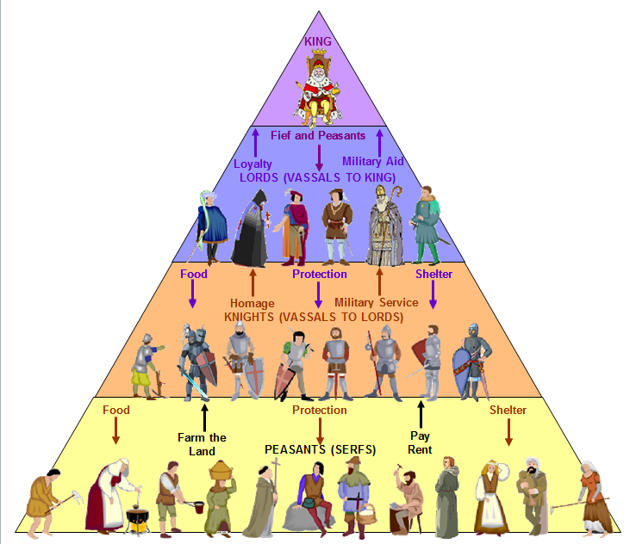
Feudalism
A political and social system based on the granting of land in exchange for loyalty, military assistance, and other services
Characteristics:The feudal method of holding land was by fief

Slide 5
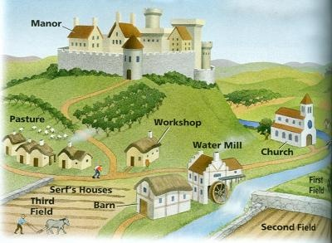
Manorlism
An economic system in the Middle Ages that was built around large estates called manors.
Characteristics:

Slide 6
Age of Chivalry
The daily life of a knight in the Middle ages followed a similar schedule to that of his lord or the noble he served.
The Daily life of a Knight during the Middle ages centered around castles or Manors or fighting for his lord and the King during times of war.
Much of his time was spent on honing his weapons skills and keeping his levels of fitness high.
(Picture of a knight)

Slide 7
Middle Ages Games
List the games knights participate in:
Examples: Archery, marbles, jousting tournaments, hammer-throwing, wrestling, chess
(Picture(s) of the games)

Slide 8
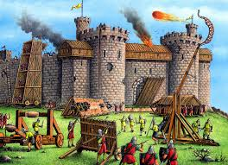
Warfare Brutality
Warrior’s role in feudal society:
Castles under siege: Boiling water, hot oil, molten lead, arrows
Picture of a castle under siege

Slide 9
Castles and Siege Weapons
Castle definition-______________
Siege weapons: siege tower, battering ram, mantlet, tortoise, mangonel, trebuchet
(Pictures of siege weapons)

Slide 10
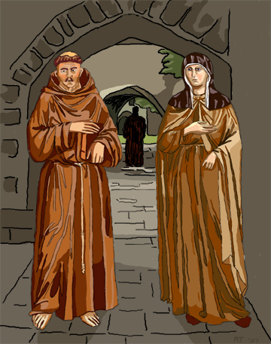
Monks and Nuns
The monks became known as Benedictines and took vows of poverty, chastity, and obedience to their leaders.
What do they do? They were required to perform manual labor and were forbidden to own property, leave the monastery, or become entangled in the concerns of society.
Nuns, who lived in convents, provided for the less-fortunate members of the community.

Slide 11
Daily Life
a. Daily life of men:________________
b. Daily life of women: The daily life of lower class women in the Middle ages was hard. Women were expected to help their peasant husbands with their daily chores as well as attending to provisions and the cooking of daily meals and other duties customarily undertaken by women.
c. Daily life of children:____________
d. Picture of daily life in the Middle Ages

Slide 12
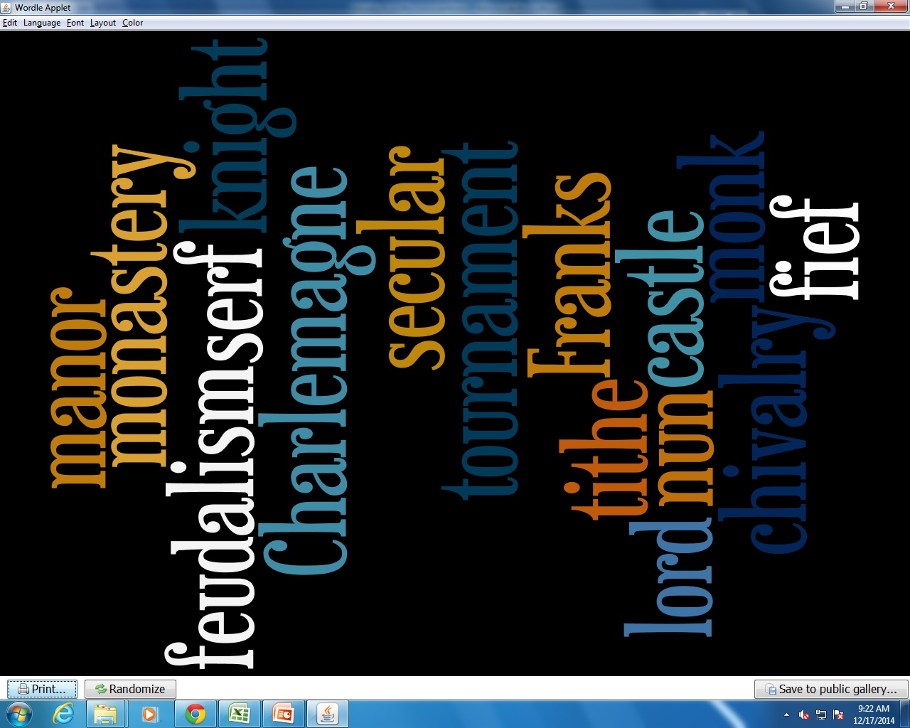
Word Wall
Franks, monastery, secular, Charlemagne, feudalism, lord, fief, vassal, knight, serf, manor, tithe, noble, chivalry, castle, tournament, troubadour

