Slide 1
Ancient Rome

Slide 2
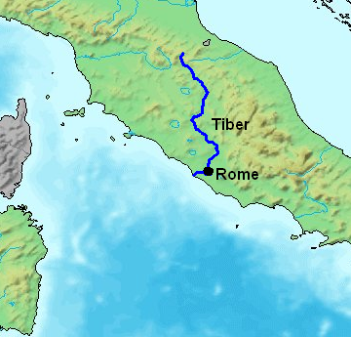
In the Beginning…
Ancient Rome begin as a group of villages along the Tiber River in what is now Italy.
Around 750 B.C. these villages united to form the city of Rome.

Slide 3
Formation of Roman Republic
For more than 200 years, kings ruled Rome.
In 509 B.C. Rome became a republic.
The Roman Senate was an assembly of elected representatives. It was the single most powerful ruling body of the Roman Republic.

Slide 4
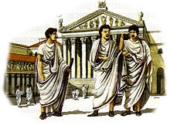
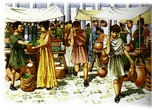
Patricians & Plebeians
In the beginning most of the people elected to the Senate were patricians.
Patricians controlled the law since they were the only citizens allowed to be judges.
Plebeians had the right to vote, but could not hold public office until 287 B.C, when they gained equality with patricians.

Slide 5
Roman Expansion
Under the leadership of ambitious generals, Rome’s highly trained soldiers took over most of the land surrounding the Mediterranean.
The ancient Romans called the Mediterranean mare nostrum, meaning “our sea”.

Slide 6
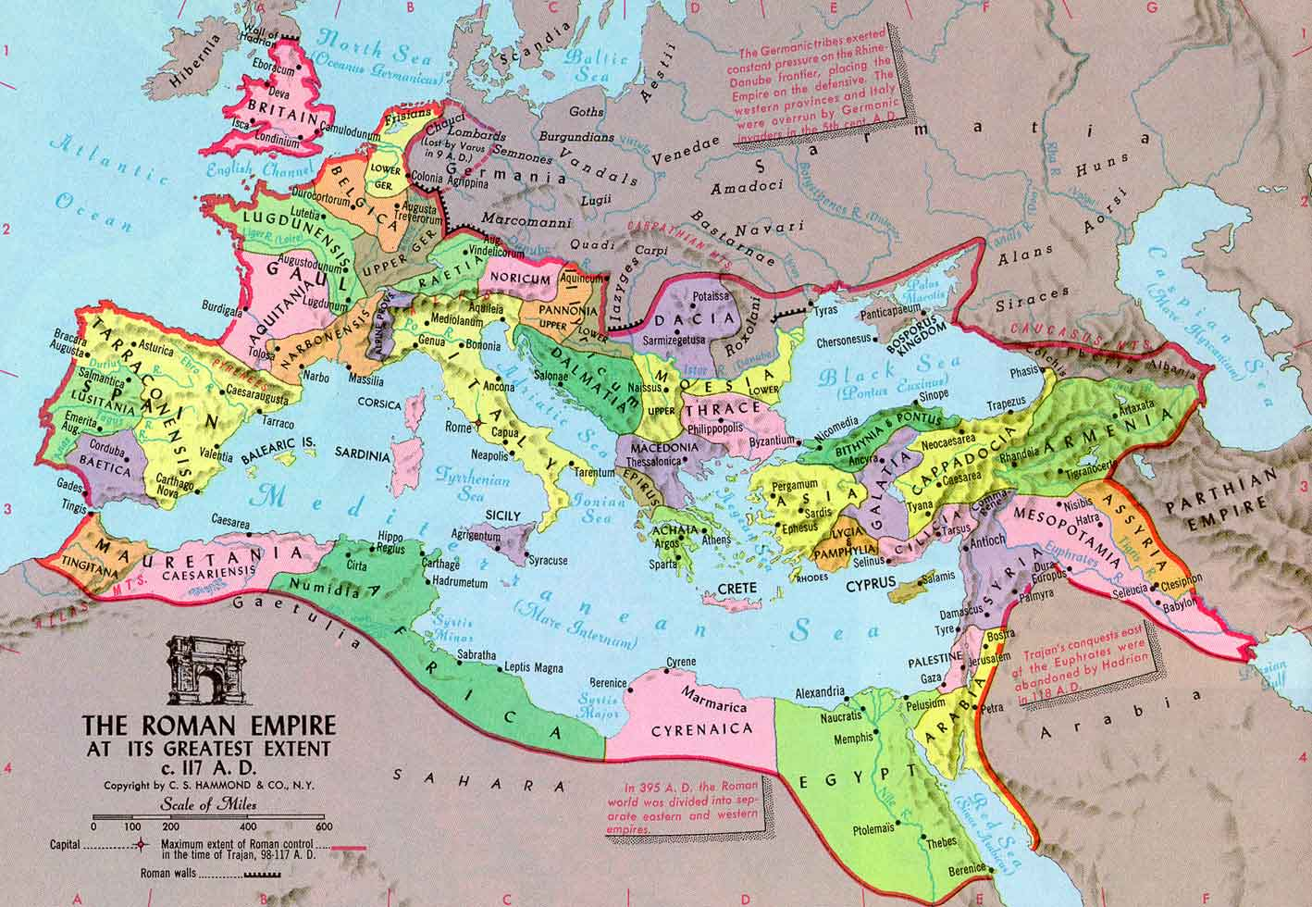
Rome 117 A.D.

Slide 7
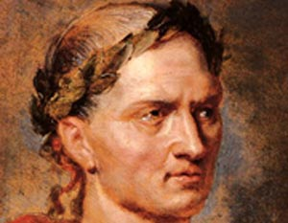
The End of the Roman Republic
A successful Roman general and famous speaker, Julius Caesar, was a governor of the territory of Gaul and managed to take control of many nearby territories.
Fearing him the Roman Senate ordered him to resign…but he had other ideas.
Caesar fought for control and won, becoming the dictator of the Roman world, ending the Roman Republic.

Slide 8
The Roman Empire
Less than a year after gaining power a group of angered Senators stabbed Caesar to death on the floor of the Roman Senate. (March 15, 44 B.C.)
This caused a civil war that lasted several years.
In 27 B.C., Caesar’s adopted son, Octavian was named the first emperor of Rome.

Slide 9
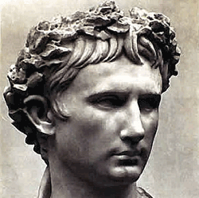
The Roman Empire
An empire is a nation or group
of territories ruled by a single powerful leader, or emperor.
As emperor Octavian took the name Augustus.
Augustus ruled the Roman Empire for more than 40 years, known as the Augustan Age.

Slide 10
The Augustan Age
During the rule of Augustus the Roman empire continued to expand.
Augustus kept soldiers along all the borders to keep peace in the Roman world.
During this time architects and engineers built many new public buildings.

Slide 11
The Augustan Age
During this time trade increased with olive oil, wine, pottery, marble, and grain being shipped all across the Mediterranean.
Lighthouses were constructed to guide ships into port.
This was also a time of great Roman literature.

Slide 12
The Rise of Christianity
After the death of Augustus in 14 A.D. a new religion begin to spread: Christianity.
At first it took hold in the eastern half of the Roman Empire.
By 200 A.D. this religion had spread throughout the empire.

Slide 13
The Rise of Christianity
Christians were viewed with suspicion and suffered persecution and many were punished or killed for their beliefs.
Things changed when Constantine became emperor of Rome in 306 A.D. During his reign Christianity became the official religion of the Roman Empire.

Slide 14
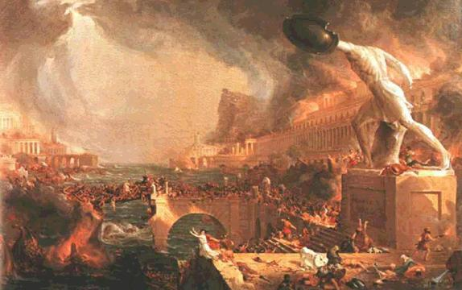
The Fall of the Roman Empire
Rome had quite a run…First a monarchy, then a republic, then an empire – all roads led to Rome for over 1200 years.
In the Mediterranean, Rome was in charge.
Rome had some wonderful emperors. Rome also suffered from a series of bad, corrupt and just plain crazy emperors.
Credit: http://rome.mrdonn.org/fall.html

Slide 15
The Fall of the Roman Empire
The empire was too large to govern effectively.
The army was not what it used to be. There was corruption in the military - dishonest generals and non-Roman soldiers.
Civil wars broke out between different political groups.
Emperors were often selected by violence, or by birth, so the head of government was not always a capable leader.
The increased use of slaves put many Romans out of work
The rich became lazy and showed little interest in trying to solve Rome problems.
The poor were overtaxed and overworked. They were very unhappy.
Prices increased, trade decreased.
The population was shrinking due to starvation and disease. That made it difficult to manage farms and government effectively.
The Empire starting shrinking. The Huns, Visigoths, Franks, Vandals, Saxons and other barbarian tribes overran the empire.
Credit: http://rome.mrdonn.org/fall.html

Slide 16
The Fall of the Roman Empire
The ancient Romans tried to solve some of their problems by splitting the Roman Empire in half, hoping that would make the empire easier to manage.
Each side had an emperor, but the emperor in charge was the emperor of the western half, the half that included the city of Rome.
The Western Roman Empire did not do well. Instead of getting stronger, they became weaker. By 400 AD, it was pretty much over. The Huns, Franks, Vandals, Saxons, Visigoths – any of these barbarian tribes might have been the group that finally brought Rome down.
They were all attacking various pieces of the Western Roman Empire. In 476 AD, the Visigoths sacked Rome. Europe entered the Dark Ages. The eastern half of the Roman Empire received a new name – the Byzantine Empire. The Byzantine Empire did fine. It lasted for another 1000 years!
Credit: http://rome.mrdonn.org/fall.html

Slide 17
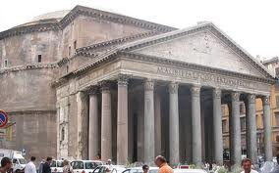
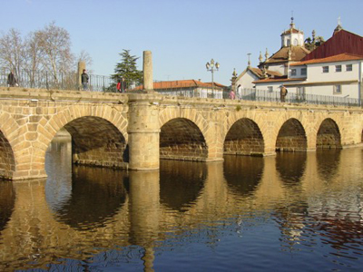
Fun Facts About Rome
One of the things the Romans are most famous for is their architecture.
The Romans brought a lot of new ideas to architecture, of which the three most important are the arch, the baked brick, and the use of cement and concrete.
Roman architecture inspired the design of the U.S. Capitol building!

Slide 18
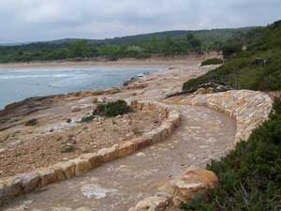
Fun Facts About Rome
The Romans built thousands of miles of road to connect the entire empire.
These roads were used up until about 100 years ago when technology advanced!

Slide 19
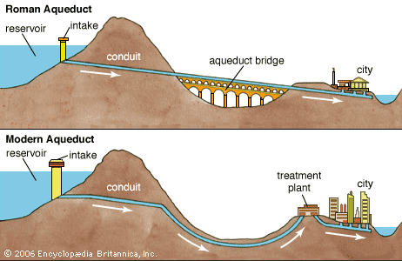
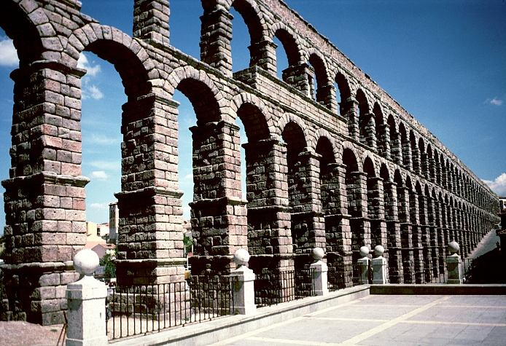
Fun Facts About Rome
The Romans were the first to build aqueducts.
The running water, indoor plumbing and sewer system carrying away disease from the population within the Empire wasn't surpassed in capability until very modern times.

Slide 20
Fun Facts About Rome
In the times of Ancient Rome very few people had baths in their homes. Adults enjoyed going to the public bathhouse. Children were not allowed in. The bathhouse cost very little to get in, so people used them often. The men and the women both used the bathhouse, but at different times during the day. Each group had a scheduled time, although the women's scheduled time was shorter.
Bath houses were huge and housed much more than pools.
Exercise grounds, gymnastic apparatus, courts for games, libraries, rooms for reading and conversation--all these things could be found in the Roman bath house.
The people made a point of going to the bath to meet their friends and associates.

Slide 21
Fun Facts About Rome
The Romans didn't use soap. They cleaned themselves by covering their bodies with oil. Then they scraped the oil off with a special scraper called a strigil. Strigils were make from bone or metal. Next the Romans enjoyed several pools. Each of these pools had water heated to different temperatures. Bathers went from one bath to another.
Caldarium, tepidarium, frigidarium
Ancient Rome had as many as 900 public baths. Small baths held about 300 people. The largest bath held 1500 people. Bathhouses were built all over the Roman Empire. The most impressive ones were found in the city of Rome. They were decorated with marble and statues.

Slide 22
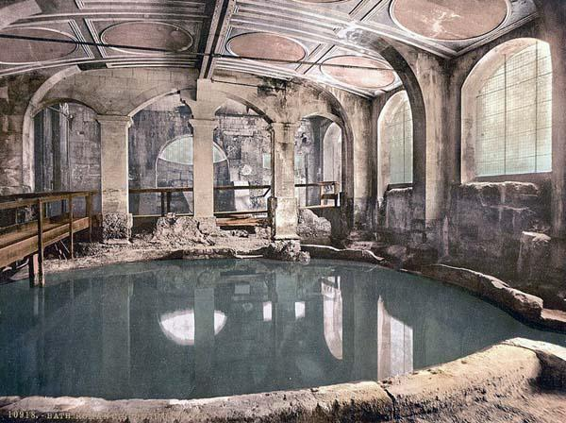
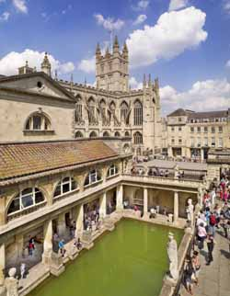
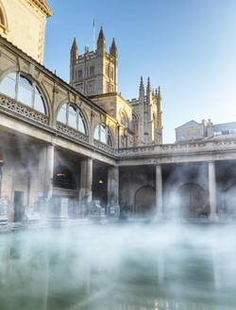
Fun Facts About Rome

