Slide 1
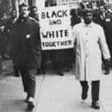
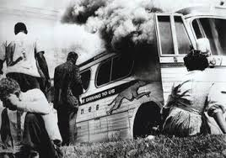
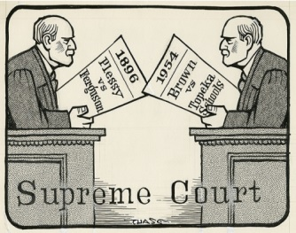
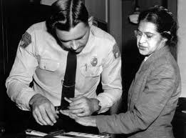
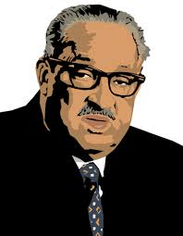
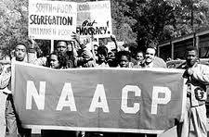
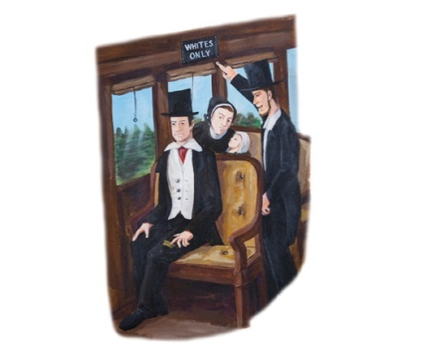
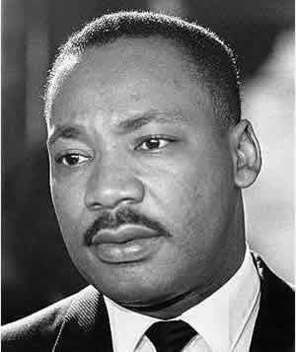
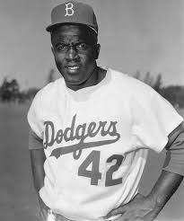
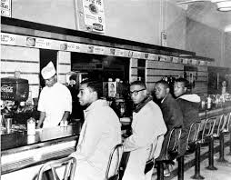
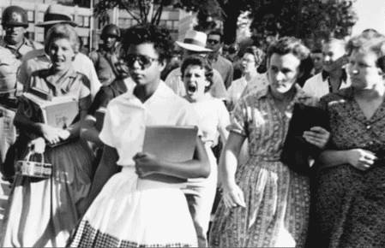
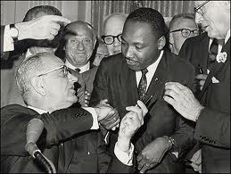
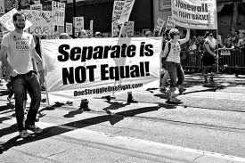
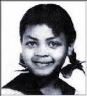
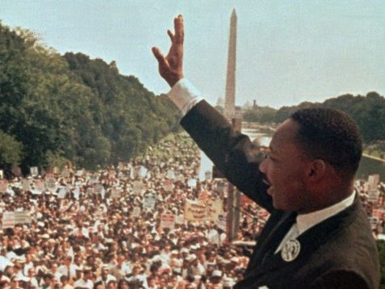
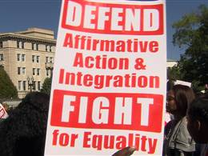
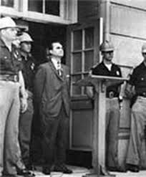
The Civil Rights Movement

Slide 2
Civil War Amendments
During the early years of our nation, slavery was permitted in many areas.
But after the Civil War things began to change, these changes became law with constitutional amendments.
  13th Amendment – (1865) abolished slavery
  14th Amendment – (1868) provided for equal protection under the law and gave those born here citizenship.
  15th Amendment – (1870) gave former male slaves suffrage or the right to vote.
These amendments to the Constitution were the foundation of the Civil Rights Movement of the Twentieth Century.

Slide 3
Journal #1
List five facts from this video.
https://www.brainpop.com/socialstudies/ushistory/civilrights/

Slide 4
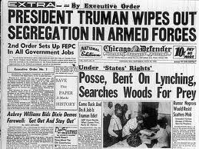
The Truman Years, 1945-1953
In 1947, Jackie Robinson, the grandson of a slave, became the first African American to play Professional Baseball.
https://www.youtube.com/watch?v=GlaUzQgRKPI
“42” opened the door for many African Americans and other minorities in different fields of sports, entertainment, and business.
The following year Pres. Truman issued an executive order that desegregated the military and ended discrimination in hiring practices by federal government.
https://www.youtube.com/watch?v=I9RHqdZDCF0

Slide 5
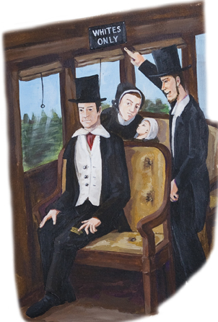
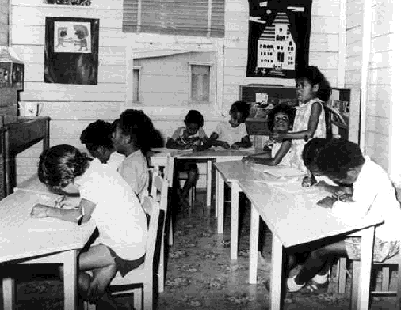
Plessy v. Ferguson, 1896
The Supreme Court decision of ‘Plessy v. Ferguson’ upheld the constitutionality of segregation laws.
The Court ruled ‘separate but equal’ was constitutional.
States could legally provide segregated facilities as they were equal in quality.
Although schools were supposed to be equal, most schools in the South were greatly inferior to white schools.
NAACP lawyers began challenging this doctrine in the court system.
https://www.youtube.com/watch?v=OKXty_E2Y58

Slide 6
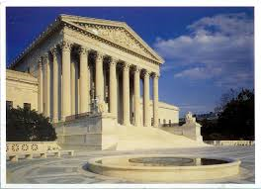
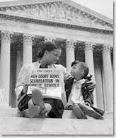
Brown v. Board of Education, 1954
Civil Rights were won in large part through litigation – resolving disputes in court.
The 1954 Supreme Court case of Brown v. Board of Education was central to the success of the Civil Rights Movement.
After the end of the Civil War, Southern states passed Jim Crow Laws.

Slide 7
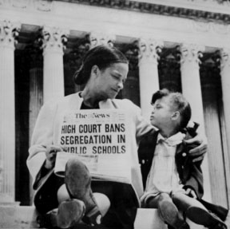
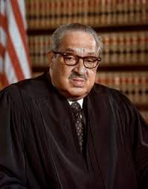
The Brown Decision
1954, Thurgood Marshall lawyer for NAACP. Argued the Brown v.Board. that Linda Brown, an African American girl, should be allowed to attend a white school closer to her home.
Chief Justice Earl Warren wrote the unanimous decision for the Supreme Court.
Brown v. Board of Education overturned the Plessy v. Ferguson
ended legal segregation in public schools!
Linda Brown
Thurgood Marshall became FIRST African American Supreme Court Justice

Slide 8
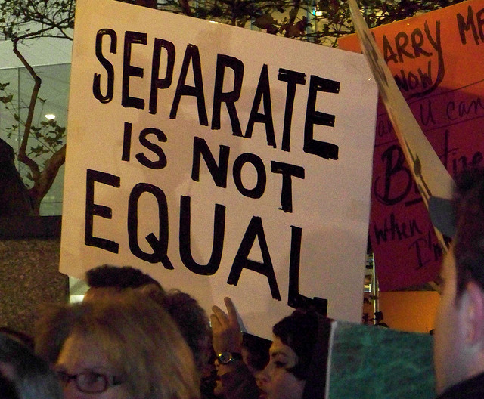
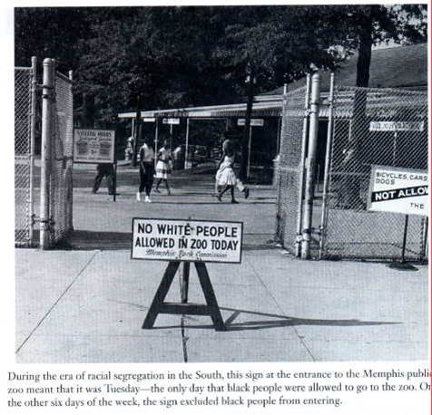
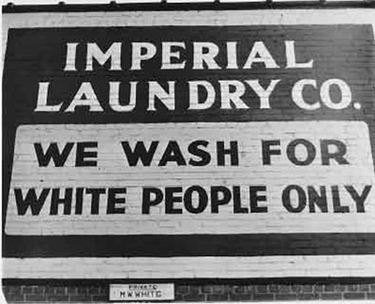
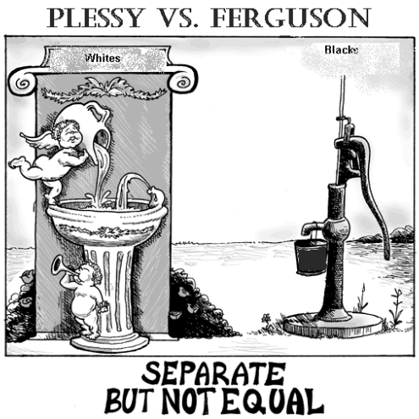
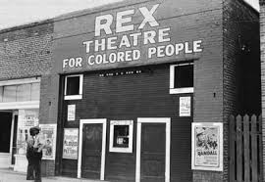
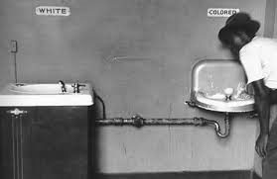
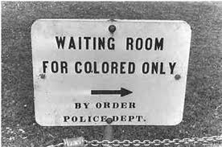
‘Separate but Equal’ ?

Slide 9
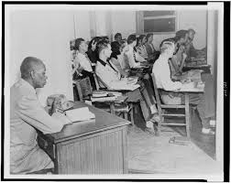

Sweatt v. Painter, 1950
Sweatt v. Painter was a case won by the NAACP involving the right of Herman Sweatt, an African American, to attend Law School at the University of Texas.
UT had even created a separate law school for African Americans, just to keep Sweatt out.
The Supreme Court ruled this separate school failed to qualify as “separate but equal”, since it isolated its students.

Slide 10
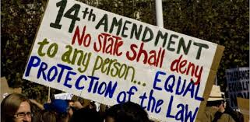
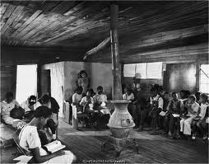

NAACP Challenges ‘Separate But Equal’
In 1953, the NAACP challenged a Kansas court ruling that African American students were denied admission to an all-white school.
The NAACP alleged that segregated schools denied African American children the ‘equal protection’ of the law due them under the 14th Amendment.
Segregated schools were inherently inferior since it sent the message they were not good enough to be educated with others.

Slide 11
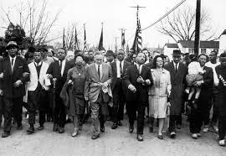
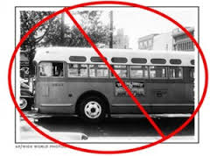
The Montgomery Bus Boycott, 1955-56
1955, Rosa Parks refused to give up her seat on a Montgomery, Alabama bus to a white passenger.
Alabama’s ‘Jim Crow’ laws made this illegal and she was arrested.
Dr. Martin Luther King Jr. led a peaceful boycott of the bus line that lasted for 13 months.
The non-violent boycott worked and a court ruled that the bus line had violated the ‘equal protection’ clause of the 14th Amendment.

Slide 12
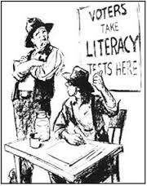
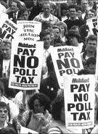
Civil Rights Act, 1957
1957, Pres. Eisenhower passed the Civil Rights Act to increase African American voting in the South.
Outlawed various ‘Jim Crow’ laws had limited the ability of blacks to vote without paying a poll tax or passing a literacy test.
Act created a Civil Rights Commission giving federal courts the power to register African American voters.
Registration procedures were so complex that the act proved to be ineffective, but it helped set the pattern for later civil rights legislation.

Slide 13
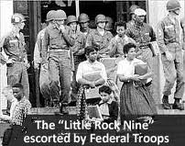
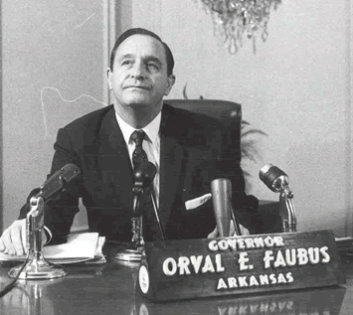
The Little Rock Nine
Southern states delayed putting the ‘Brown’ decision into action.
Arkansas Governor Orval Faubus ordered the Arkansas National Guard to surround Little Rock’s ‘Central High’ to prevent 9 African American students from enrolling.
Pres. Eisenhower ordered federal troops to Little Rock to ensure the Little Rock Nine could safely attend school.
Gov. Fabus closed the school until the courts forced its reopening.
(start at 16:00 min!) http://www.annenbergclassroom.org/page/an-independent-judiciary

Slide 14

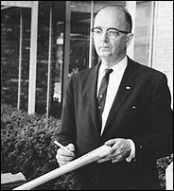
Southerners Resist Integration
Southern Bloc of Democrats in Congress banded together to use their powers to stop passage of Civil Rights laws.
1963, Alabama Gov. George Wallace stood in the doorway of University of Alabama to prevent blacks from enrolling.
1964, Lester Maddox, a white restaurant owner wielded an axe at African Americans wanting to enter his whites-only restaurant, Maddox was later elected the governor of Georgia.

Slide 15
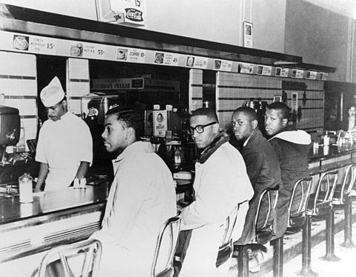
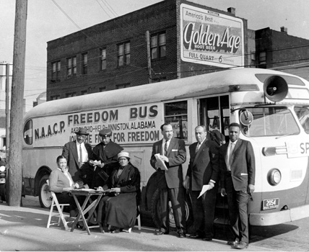
Sit-ins and Freedom Rides, 1960-61
1960, four African American students, the Greensboro Four, held a sit-in at a “Whites-Only” lunch counter in North Carolina.
The non-violent sit-ins spread!
1961, interracial groups rode buses in Freedom Rides in the South to stop segregation.
As a result of these non-violent protests lunch counters were desegregated and the federal government was forced to help.

Slide 16
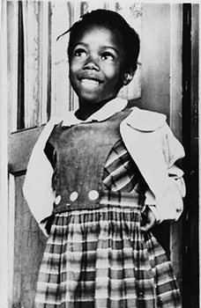
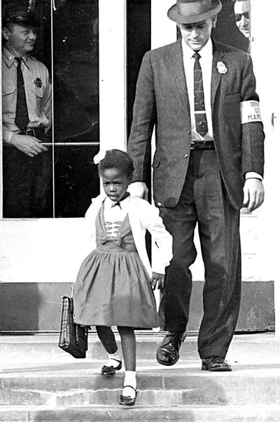
Ruby Bridges
1960
First African American to attend the all white school in her neighborhood in New Orleans.
https://www.youtube.com/watch?v=ecBORXfap9A

Slide 17
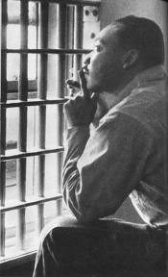
MLK’s ‘Letter from a Birmingham Jail
MLK was emerging as the leader of the Civil Rights Movement with non-violence to resist unjust laws.
King’s followed in Gandhi’s steps in practicing civil disobedience saying ‘everyone has a moral responsibility to disobey unjust laws’.
When MLK led a march in Birmingham, Alabama he was arrested and jailed.
In a “Letter from a Birmingham Jail” MLK explained why blacks could no longer wait patiently for their rights.
https://www.youtube.com/watch?v=knFojb020bY

Slide 18
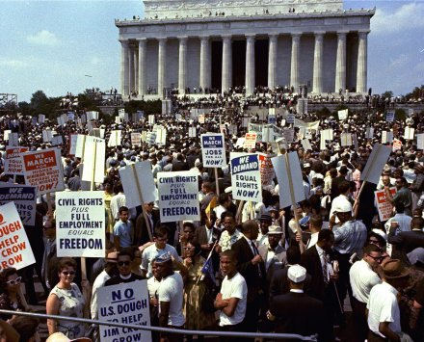
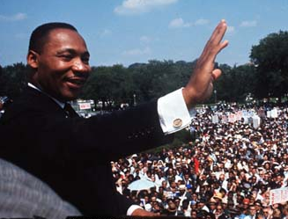
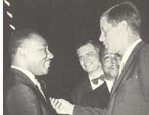
The March on Washington, 1963
1963, to gain support for a Civil Rights bill that was before Congress MLK led a ‘March on Washington’.
It would be the largest demonstration of human rights in history.
It was here that King gave his famous ‘I Have a Dream’ speech.
King would later meet with JFK.
A few months later JFK was killed, but there was a new willingness in Congress to pass legislation for Civil Rights.

Slide 19
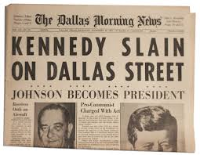


Civil Rights Act of 1964
1963, JFK is assassinated and LBJ becomes the president.
As President, LBJ pushed through new legislation on civil rights.
1964, the Civil Rights Act of 1964 is signed into law by LBJ.
The law would –
prohibit discrimination based on race, color, religion, or ethnic background in hotels, restaurants, and all places of employment doing business with the federal government.

Slide 20



The Struggle for Voting Rights
1964, Twenty-Fourth Amendment - eliminated poll taxes in federal elections. (Can’t charge to vote)
1965, Selma Marches – MLK led marches in Selma, Alabama to demand voting rights for African Americans, but demonstrators were attacked by the police.
1965, Voting Rights Act of 1965 - LBJ signed bill into law that ended poll taxes and led to an increase in number of black voters.

Slide 21


Affirmative Action, 1965
1965, LBJ signs Executive Order requiring employers with the federal government to take positive steps to increase minority employees, later women were added.
Affirmative Action programs increased number of minorities in colleges and businesses, but some said this was a form of reverse discrimination.
In “Regents of U. of California v. Bakke”, the Supreme Court upheld affirmative action, but not use of racial quotas.

Slide 22



Billy Graham
One outspoken supporter of civil rights was Billy Graham.
Billy Graham a Christian preacher and spiritual advisor to several presidents.
Graham became an opponent of segregation and had even paid to get MLK out of jail.
Graham advised Eisenhower to send troops to protect the Little Rock Nine.

Slide 23

Malcolm X
Muslim minister
Advocated violence, when necessary
Known as the “opposite” of MLK in his tactics, but still wanted equality.
(first two min) https://www.youtube.com/watch?v=h4PqLKWuwyU

Slide 24


More influential people.
Shirley Chisholm
  First African American elected to the US Congress.
Barbara Jordan
  First African American woman elected to the TEXAS State Senate.

