Slide 1
Final Regents
Review:
Rome
By: Susan M. Pojer
Horace Greeley H.S. Chappaqua, NY

Slide 2
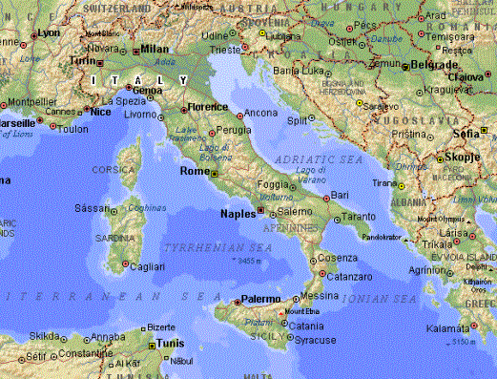
The Geography of Rome

Slide 3
The History
of
Ancient Italy

Slide 4
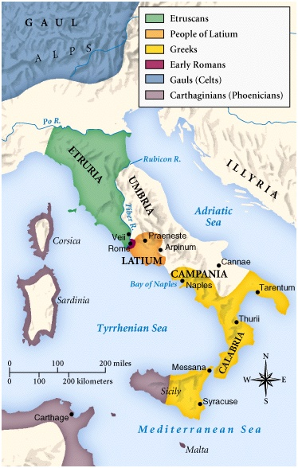
Italy in 750 BCE

Slide 5
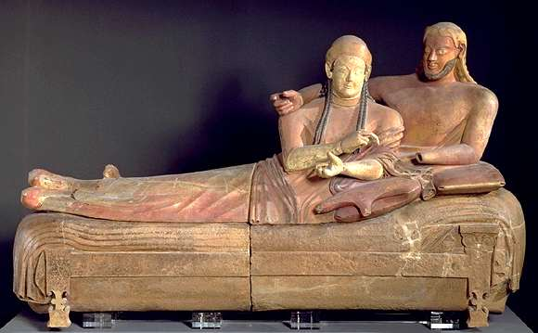
Influence of the Etruscans
Writing
Religion
The Arch

Slide 6
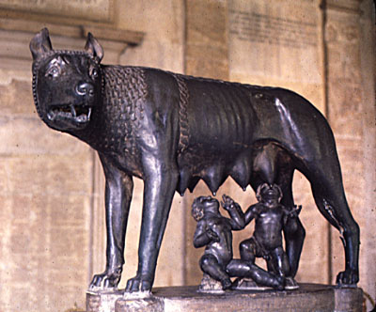
The Mythical Founding of Rome:
Romulus & Remus

Slide 7
The Roman
Republic:
509 BCE - 27 BCE

Slide 8
Republican Government
2 Consuls
(Rulers of Rome)
Senate
(Representative body for patricians)
Tribal Assembly
(Representative body for plebeians)

Slide 9
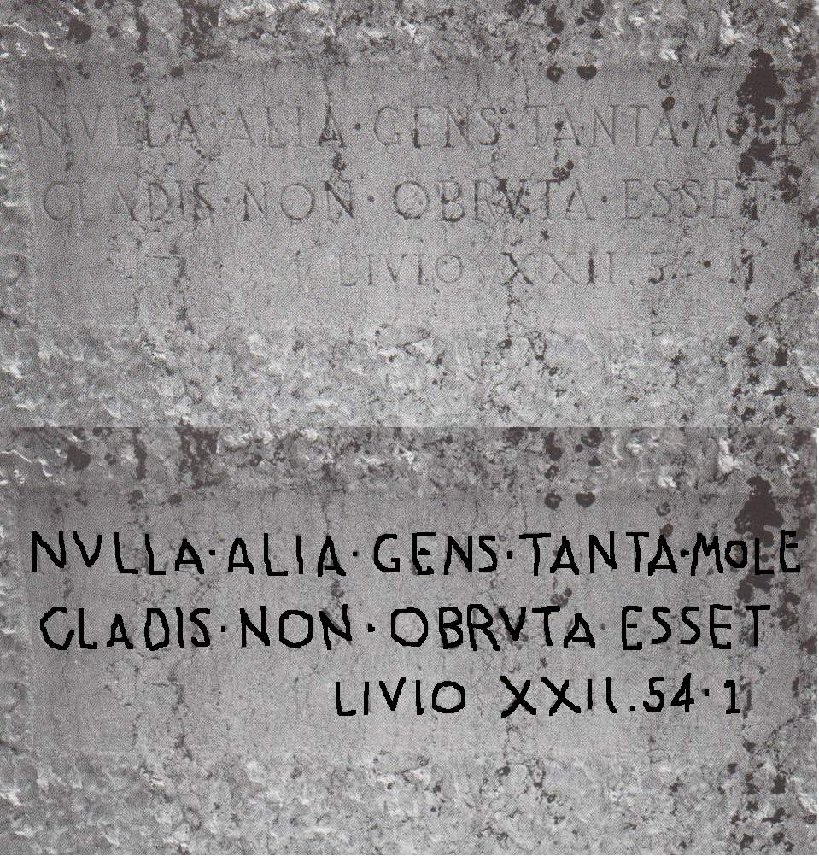
The Twelve Tables, 450 BCE
Providing political and social
rights for the plebeians.

Slide 10
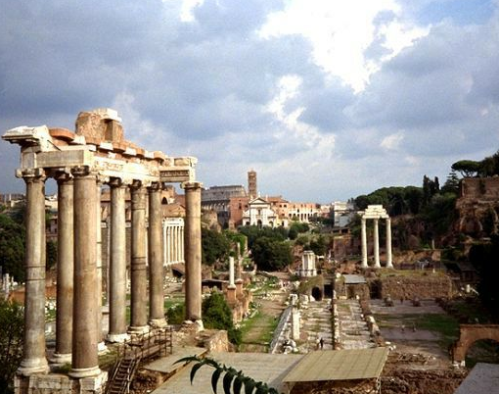
The Roman Forum

Slide 11
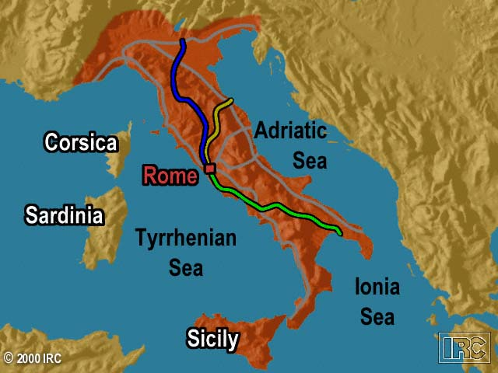
Rome’s Early Road System

Slide 12
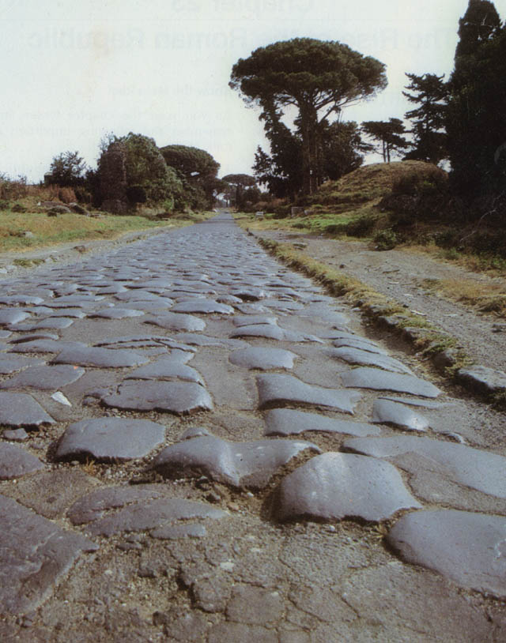
Roman Roads:
The Appian Way

Slide 13
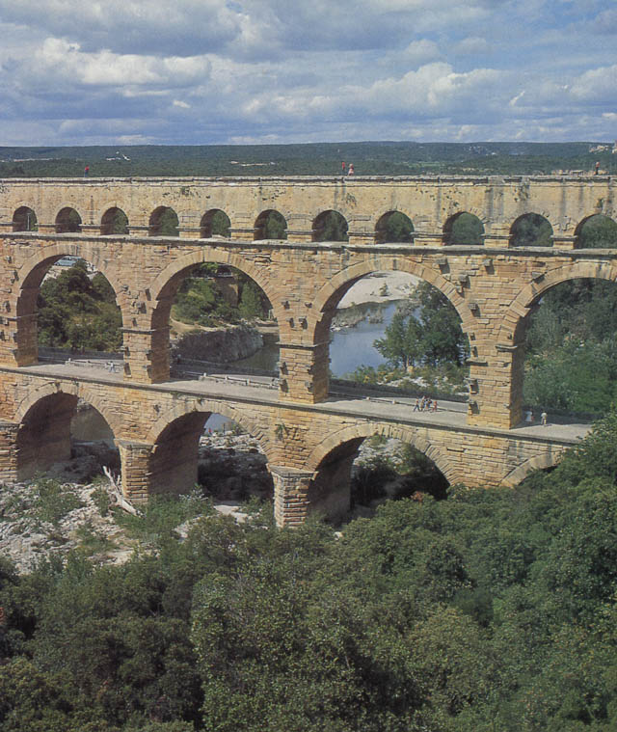
Roman Aqueducts

Slide 14
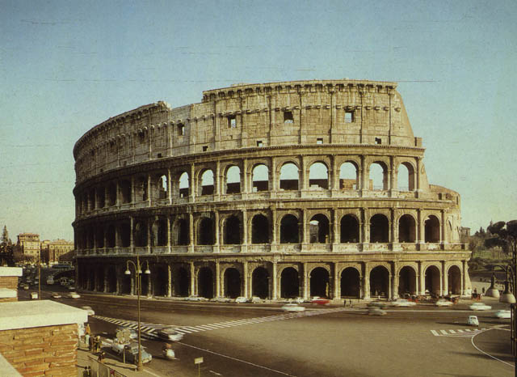
The Roman Colosseum

Slide 15
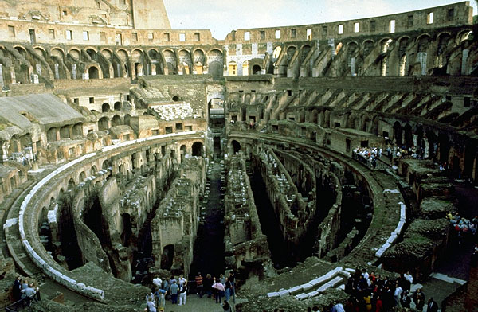
The Colosseum Interior

Slide 16
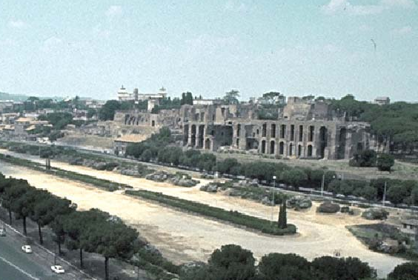
Circus Maximus

Slide 17
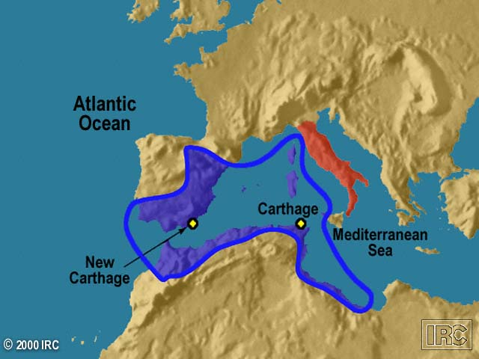
Carthaginian Empire

Slide 18
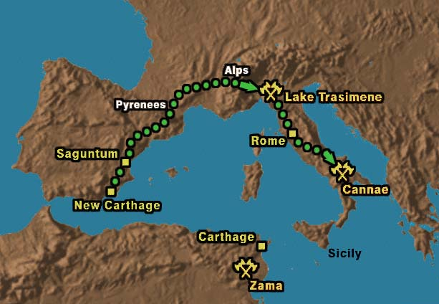
Hannibal’s Route

Slide 19
Reform Leaders
Tiberius and Gaius Gracchus
  the poor should be given grain and small plots of free land.
Military Reformer
Gaius Marius
  recruited an army from the poor
  and homeless.
  professional standing army.

Slide 20
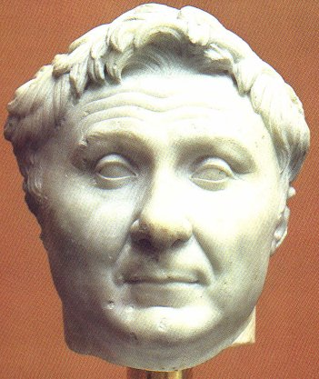
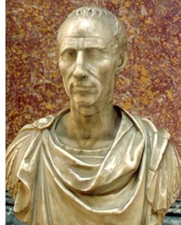
Civil War & Dictators
Julius Caesar
Pompey

Slide 21
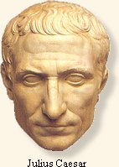
Crossing the Rubicon, 49 BC
The Die is Cast!

Slide 22
The First Triumvirate
Julius Caesar
Marcus Licinius Crassus
Gaius Magnus Pompey

Slide 23
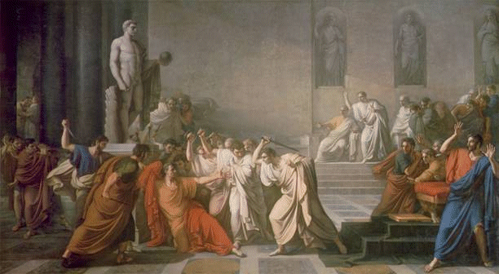
Beware the Ides of March!
44 BCE

Slide 24
The Second Triumvirate
Octavian Augustus
Marc Antony
Marcus Lepidus

Slide 25
The
Roman Empire:
27 BCE - 476 CE

Slide 26
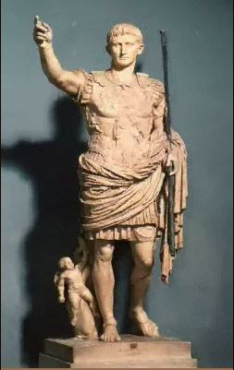
Octavian Augustus:
Rome’s First Emperor

Slide 27
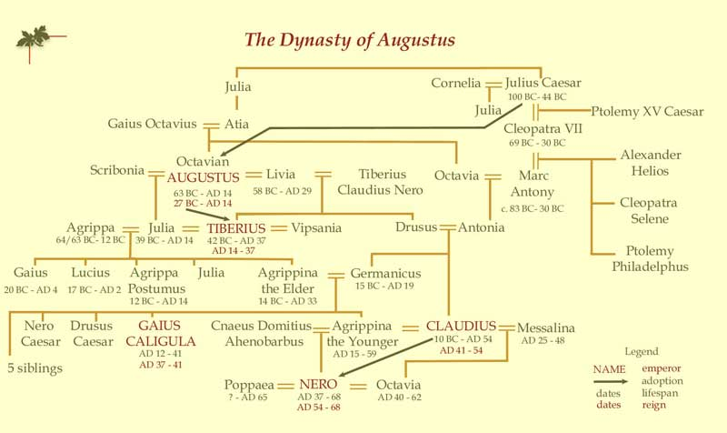
The First Roman Dynasty

Slide 28
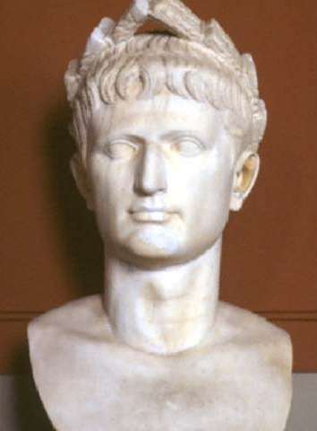
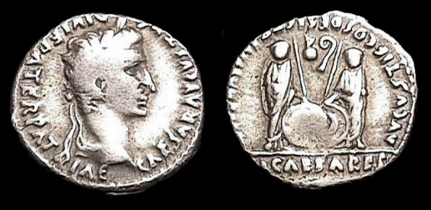
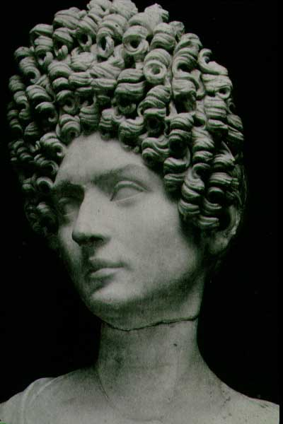
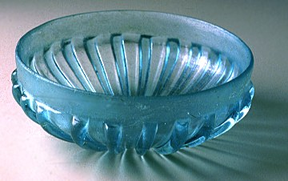
Pax Romana: 27 BCE – 180 CE

Slide 29
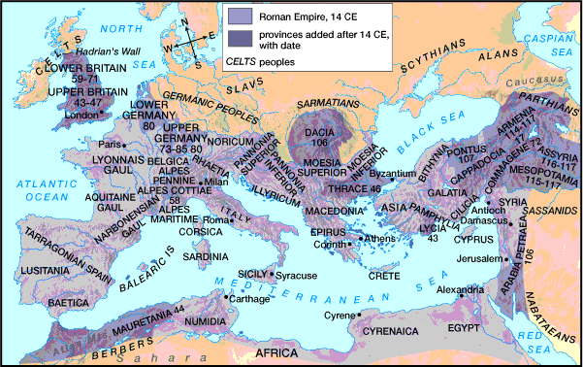
The Greatest Extent of the Roman Empire – 14 CE

Slide 30
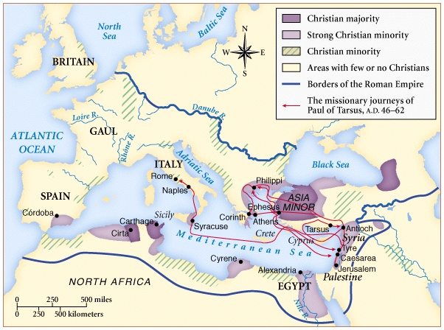
The Rise of Christianity

Slide 31
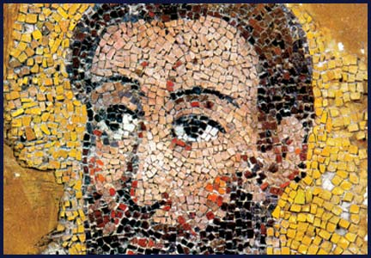
St. Paul:
Apostle to the Gentiles

Slide 32
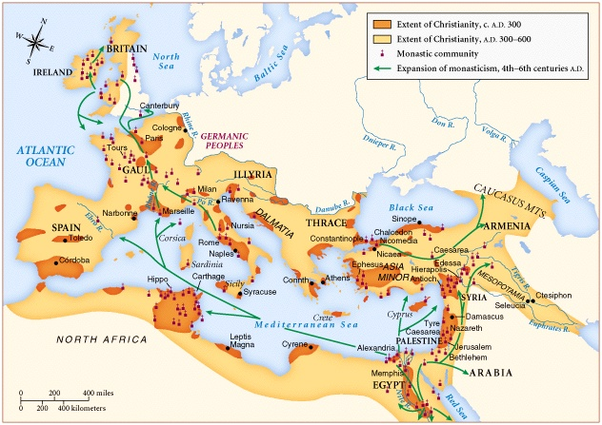
The Spread of Christianity

Slide 33
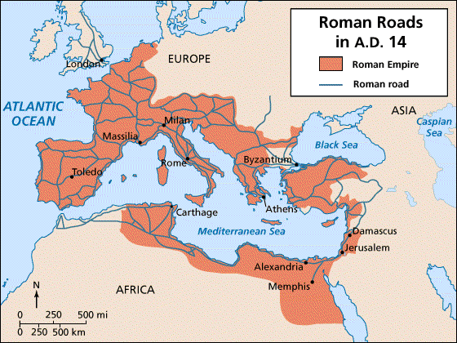
Imperial Roman Road System

Slide 34
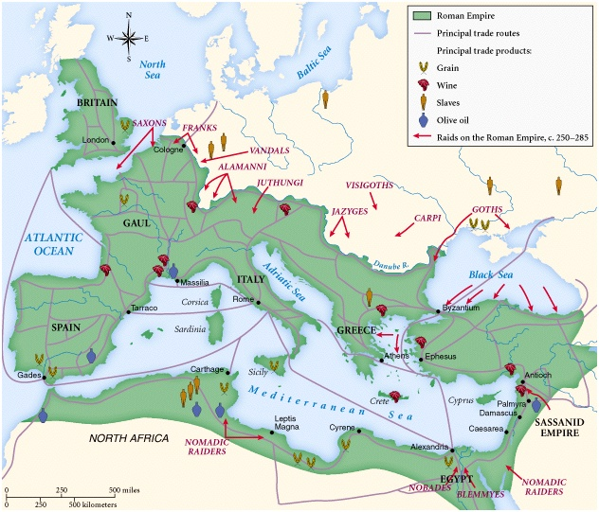
The Empire in Crisis: 3c

Slide 35
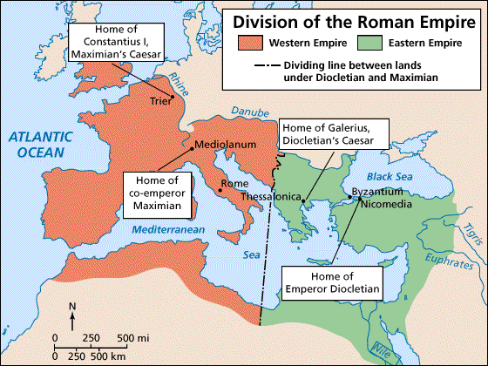
Diocletian Splits the Empire in Two: 294 CE

Slide 36
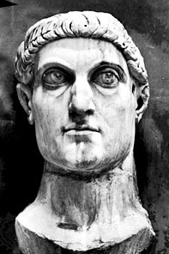
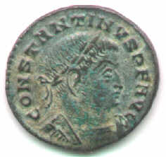
Constantine: 312 - 337

Slide 37
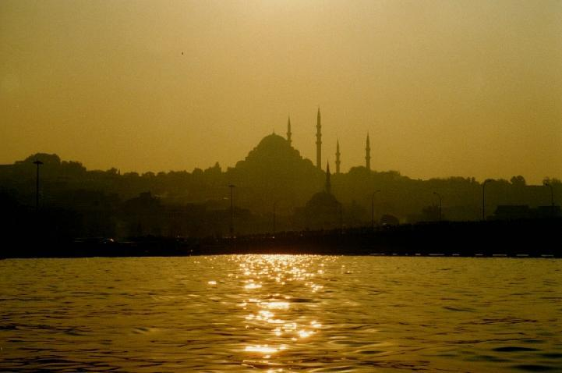
Constantinople: “The 2nd Rome” (Founded in 330)

Slide 38
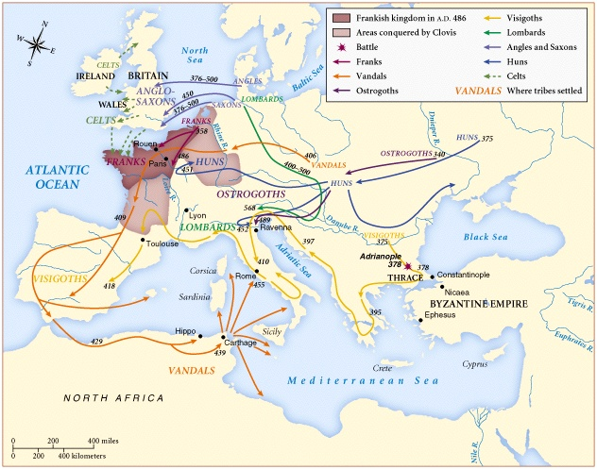
Barbarian Invasions: 4c-5c

Slide 39
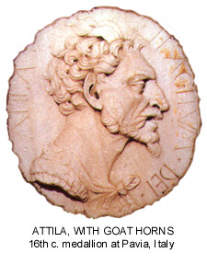
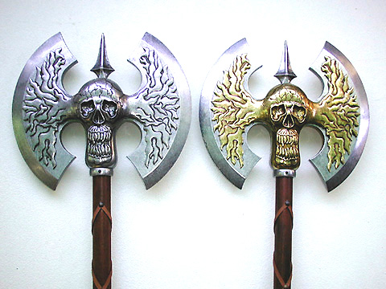
Attila the Hun:
“The Scourge of God”

Slide 40
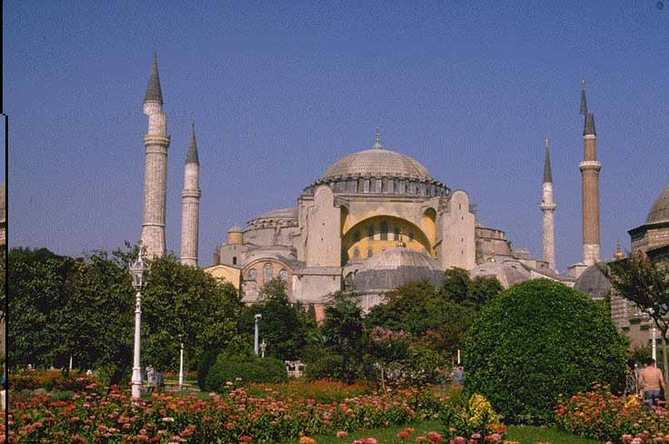
Byzantium:
The Eastern Roman Empire

Slide 41
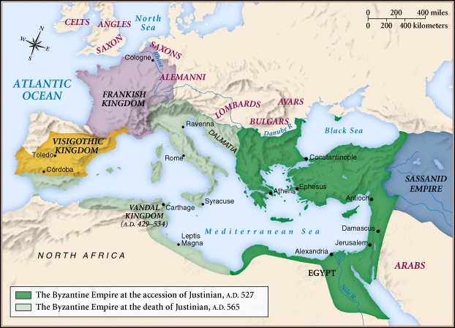
The Byzantine Empire
During the Reign of Justinian

Slide 42
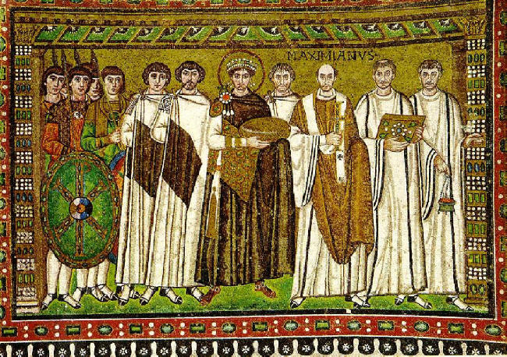
The Byzantine Emperor Justinian

Slide 43
The Legacy of Rome
Republic Government
Roman Law
Latin Language
Roman Catholic Church
City Planning
Romanesque Architectural Style
Roman Engineering
    Aqueducts
    Sewage systems
    Dams
    Cement
    Arch

