Slide 1
THE RISE OF CIVILIZATION
Early River Valley Civilizations:
3500 B.C.–450 B.C
Chapter 2

Slide 2
THE BIG FOUR AREAS
Civilizations emerge and develop on fertile river plains in
Mesopotamia (Tigris Euphrates)
Egypt (Nile),
Indus Valley (Indus)
China (Huang He)

Slide 3
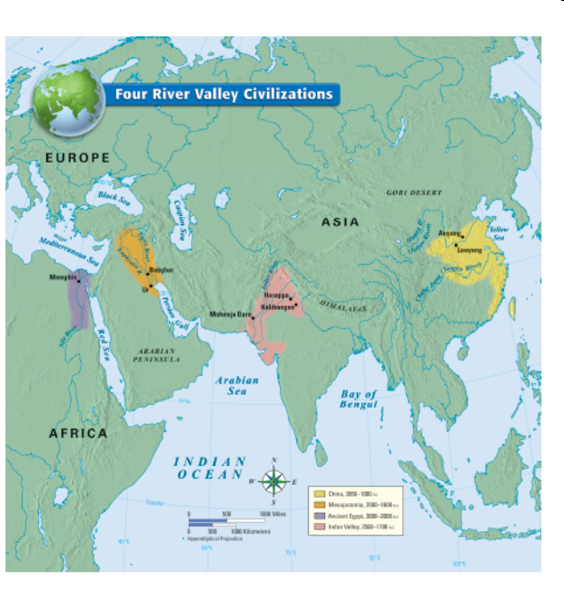
The firsts……WHAT DO THEY ALL HAVE IN COMMON?

Slide 4
How did geography effect the development of early civilizations?
Location
Climate
Physical landscape
How do they irrigate crops?
What crops do they grow?
How do they trade, over land, rivers, seas?
How do they interact with the environment?
Many more questions to ask………

Slide 5
Essay Question
At the end of this unit part of your test will be to answer the following essay question
How did geography effect the development of early civilizations?

Slide 6
What to do: Plan and Organize
Begin to gather your facts: You will take notes on civilizations in each of the 4 river valleys
As you copy notes underline anything that you see that has to do with geography
Begin to organize these facts into categories
Try to find several common themes that all the areas share
You will be allowed to bring in your organized notes to compose this essay
You will have 1 class period to compose your response to this question. You must complete this essay in class.

Slide 7
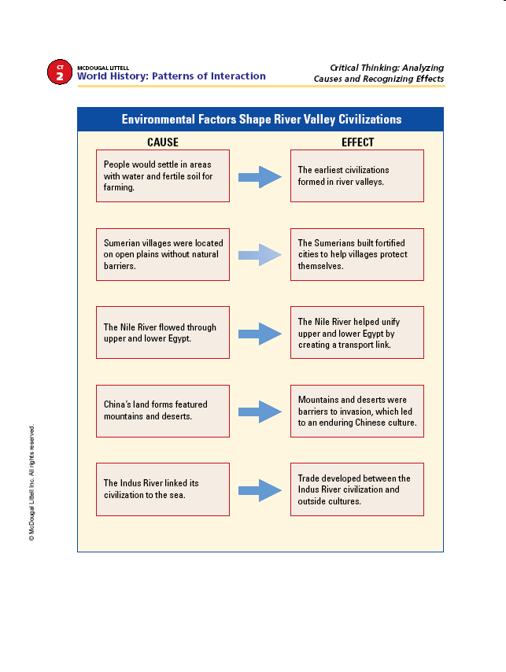

Slide 8
*
*
SECTION 1
City-States in Mesopotamia
SECTION 2
Pyramids on the Nile
SECTION 3
Planned Cities on the Indus
SECTION 4
River Dynasties in China
NEXT

Slide 9
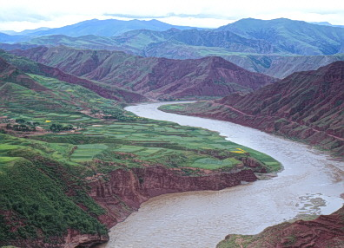
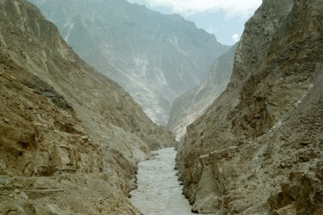
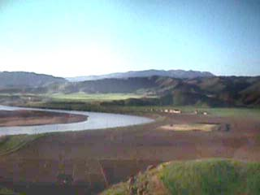
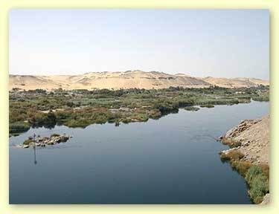
Four Early River Valley Civilizations
Huang-He River
Indus River
Tigris-Euphrates River
Nile River

Slide 10
City-States in Mesopotamia
The Fertile Crescent
• Fertile Crescent—arc of land between Persian Gulf and Mediterranean
•Includes Mesopotamia—“land between the rivers”
—a fertile plain
•Tigris and Euphrates rivers flood once a year, leaving rich soil.

Slide 11
Environment poses 3 disadvantages:
1. floods are unpredictable; sometimes no rain
2. land offers no barriers to invasion
3. land has few natural resources; building
materials scarce

Slide 12
Solving Problems Through Organization
Sumerians worked together; find solutions to
environmental challenges:
build irrigation ditches to control water and
produce crops
build walled cities for defense
trade grain, cloth, and tools for raw materials—stone, wood metal
Organization, leadership, and laws are
beginning of civilization

Slide 13
Sumerian City-States
Each is a city-state—an independent political
unit
Sumer city-states Uruk, Kish, Lagash, Umma,
and Ur
Each city has temple and ziggurat; priests appeal to gods

Slide 14
Priests and Rulers Share Control
• Sumer’s early governments a theocracy
The Spread of Cities
• By 2500 B.C. many new cities in Fertile Crescent
Sumerians exchange products and ideas with
other cultures
Cultural diffusion—process of one culture
spreading to others

Slide 15
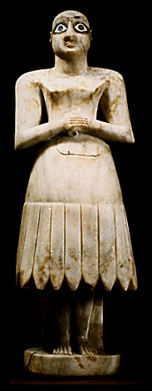
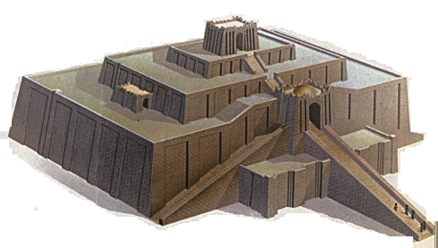
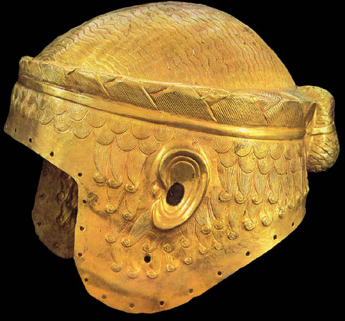
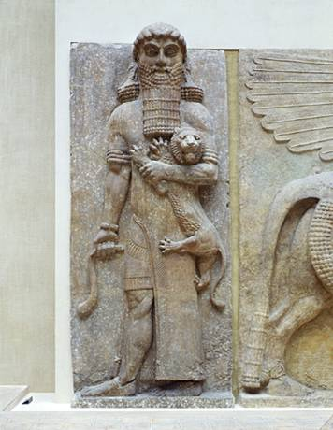
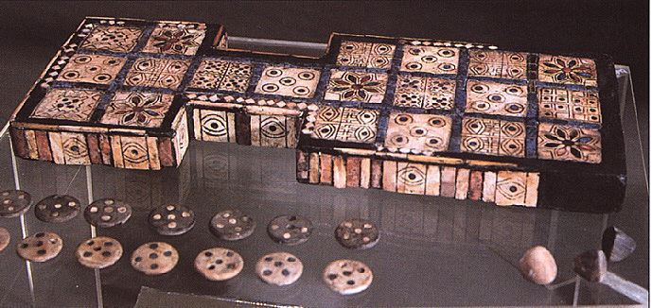
UR’s
UR’S
Artifacts

Slide 16
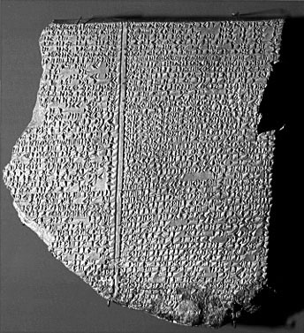
Gilgamesh Epic Tablet:
Flood Story written in cuneiform

Slide 17
polytheism
A Religion of Many Gods
Gods are thought to control forces of nature
Gods behave as humans do, but people are gods’ servants
Life after death is bleak and gloomy

Slide 18
Sumerian Science and Technology
• Sumerians invent wheel, sail, and plow; first to
use bronze
• Make advances in arithmetic and geometry
• Develop arches, columns, ramps and pyramids
for building
• Have complex system of writing—cuneiform
• Study astronomy, chemistry, medicine

Slide 19
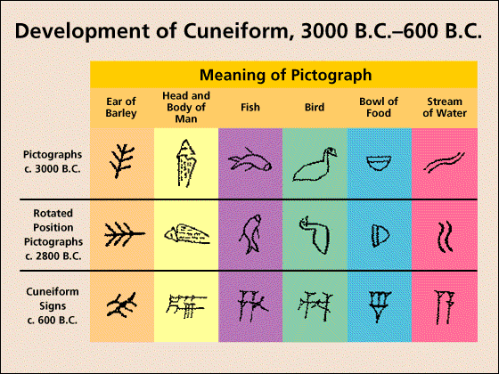
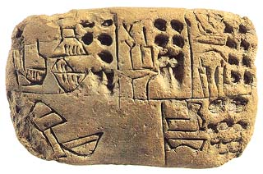
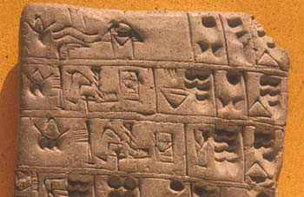
CUNEIFORM

Slide 20
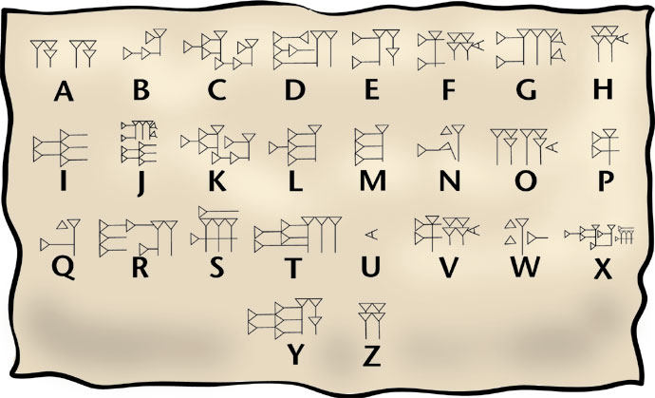
**
Innovations
Arithmetic and Geometry
  They developed a number system with a base of 60.
Architectural
  Arches, columns, ramps, and the pyramid shape of the ziggurats permanently influenced Mesopotamian civilization.
Cuneiform
  Sumerians created a writing system.

Slide 21
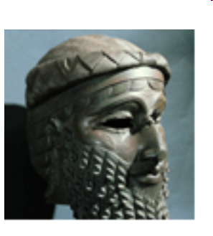
The First Empire Builders
SECTION
Time of War
•From 3000 to 2000 B.C.E. city-states at constant war
Sargon of Akkad
• Around 2350 B.C., Sargon from Akkad defeats city-states of Sumer
• Creates first empire—independent states under control of one leader: United all Mesopotamia city states
• His dynasty lasts about 200 years
* Akkadians used own language but adopted Sumerian religious and farming practices
Sargon dies and so does his empire soon after
Sargon
Continued . . .
NEXT

Slide 22
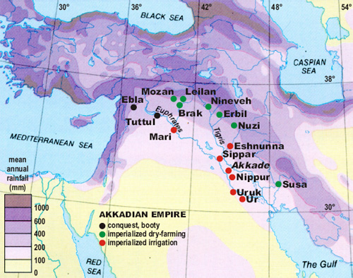
The World’s First Empire [Akkadians]

Slide 23
Babylonian Empire
Amorites also called nomadic warriors, take control of region around 2000 B.C.
Make Babylon, on Euphrates River, the capital

Slide 24
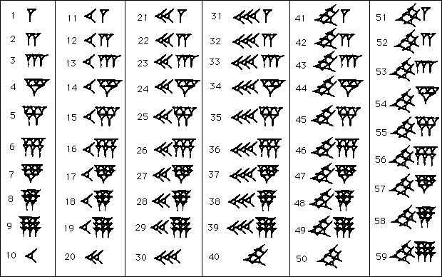
BABYLONIAN WRITING

Slide 25
Hammurabi: brought all of Mesopotamia under his control.
City of Babylon becomes major trade center
**Hammurabi’s Law Code
Hammurabi’s greatest achievement
*Collected laws from city-states and created a law code for entire region engraved in stone and made public
• 282 sections mostly dealing with daily life: specific punishments for actions
**Set different punishments depending on social class, gender
Strong government to increase economic prosperity of people

Slide 26
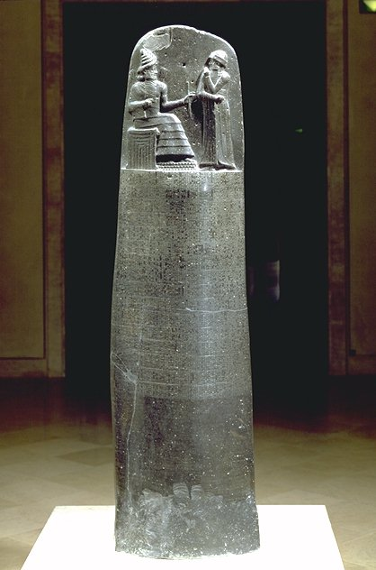
Hammurabi’s Code was the first written law code

Slide 27
Babylonian Society
SECTION
1
Social Classes:
Kings,
priests,
nobles
artisans, merchants, scribes, farmers, slaves
Slaves are those captured in war
NEXT

Slide 28
Assyrians
civilization is remembered for their great fighting ability and their great cruelty. Assyrian rule peaked about 650 BCE
___________________________________________________

Slide 29
Chaldean civilization
*
began about 600BCE interested in astronomy, Chaldeans named the days of the week after planets: Saturn: Saturday
Monday moon day Sunday : Sun day
Ruled by Nebuchadnezzar

Slide 30
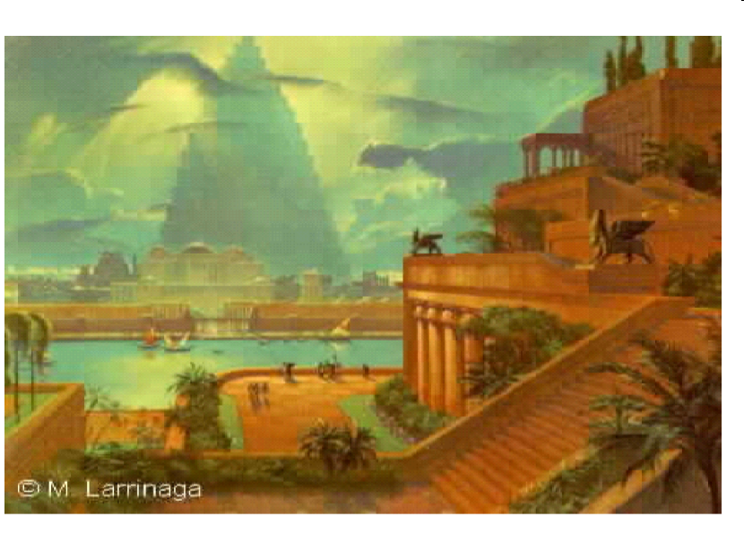
Hanging Gardens of Babylon built by Nebuchadnezzer, ruler of the Chaldeans

Slide 31
Persian Civilization 550 BCE
East of Mesopotamia
Great Rulers of Persia:
Cyrus the Great and Darius
Great Empire
Built Roads: Had Mail
**Persia is now the country of Iran

Slide 32
Chronological list of Mesopotamian Civilizations
1. Sumerians: first known Mesopotamian Civilization
2. Akkadians: Lead by Sargon: first empire builders
3. Babylonians: lead by Hammurabi first written law code
4. Assyrians: Known for extreme cruelty; great warriors
5. Chaldeans: known for studying astronomy: named a few days of the week
6. Persians: great empire lead by Daruis and Cyrus the Great and known for building roads

Slide 33
Section 1 is completed, make sure to organize for essay question
How did geography effect the development of the Mesopotamian civilizations???

Slide 34
How did geography effect the development of early civilizations?
Location
Climate
Physical landscape
How do they irrigate crops?
What crops do they grow?
How do they trade, over land, rivers, seas?
How do they interact with the environment?
Many more questions to ask………

Slide 35

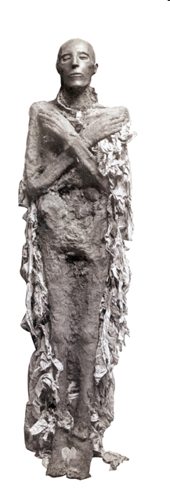
Section 2
Pyramids on the Nile
Using mathematical knowledge and engineering skills, Egyptians build magnificent monuments to honor dead rulers.
NEXT

Slide 36
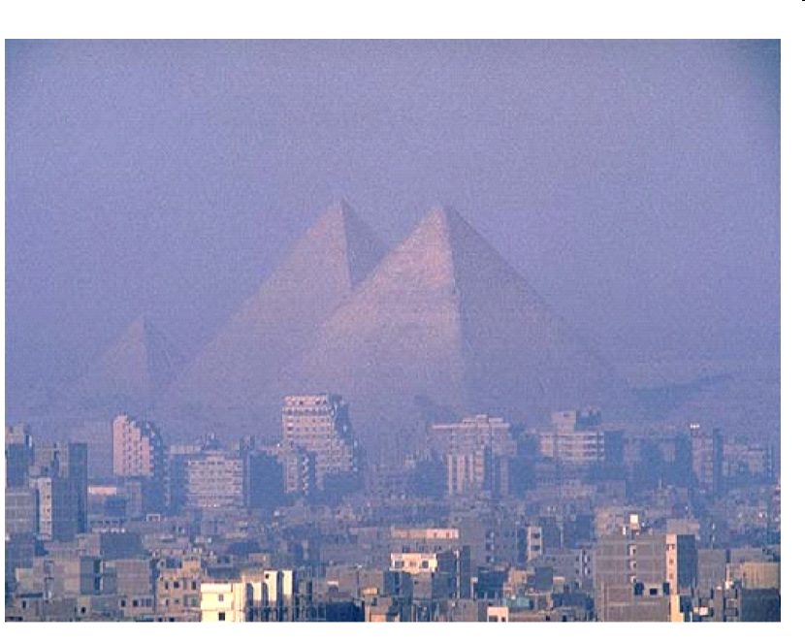
Pyramids

Slide 37
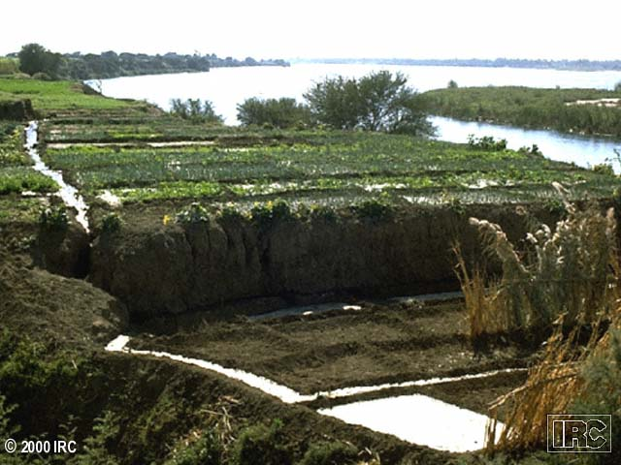
The Geography of Egypt
Egypt’s Settlements
•Arise along the 4,100-mile Nile River
on narrow strip of fertile land
The Gift of the Nile
• Yearly flooding brings water and fertile black mud—silt (inundation of the Nile)
• Farmers build irrigation system for wheat and barley crops
• Egyptian’s worship Nile as a god
Continued . . .
NEXT

Slide 38
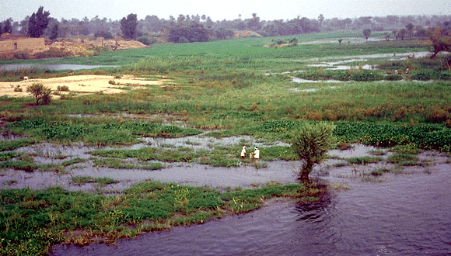
The Annual Flooding of the Nile

Slide 39
Environmental Challenges
SECTION
2
•Light floods reduce crops, cause starvation
•Heavy floods destroy property; deserts isolate and protect Egyptians
NEXT

Slide 40
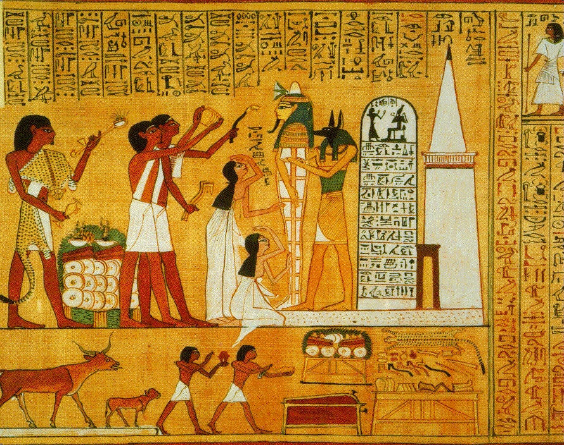
Ancient Egypt

Slide 41
Upper Egypt and Lower Egypt
• River area south of First Cataract is elevated, becomes Upper Egypt
• Cataract—where boulders turn Nile River into churning rapids
• River area north, including Nile delta, becomes Lower Egypt
• Delta—land formed by silt deposits at mouth of river; triangular

Slide 42
Famous Pharaohs
Narmer/Menes: United Upper and Lower Egypt
Invasion from Hyksos: Conquered Egypt Middle Kingdom with new weapons and horse drawn chariots
Hatshepsut: Pharaoh, stepmother to Thutmose, built elaborate funeral temple, Valley of the Kings
Amenhotep /Akhenaton (Aton): Pharaoh: Monotheism, changes name, changed religion from polytheism to monotheism

Slide 43
Famous Pharaohs
Nefertiti: Married to Akhenaton, very beautiful
Tutankhamen: Son of Akhenaton, back to polytheism, Murdered at 18, tomb found untouched by Carter in 1922 in the Valley of the Kings
Ramses II: The great builder, 52 sons, ruled for 67 years, dies at 90, Empire weakens after his death, sent Moses on Exodus
Egypt falls to the Kushites from the south and the Libyans from the west

Slide 44
Pharaohs Rule as Gods
• To the Egyptians, kings are gods; Egyptian god
kings called pharaohs
• Pharaohs control religion, government, army,
well-being of kingdom
• Government based on religious authority—
theocracy

Slide 45
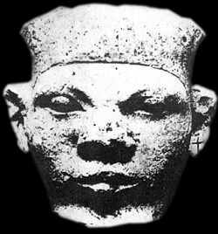
*
Egypt Unites into a Kingdom
SECTION
2
King Narmer (aka Menes) Creates Egyptian Dynasty
• Villages of Egypt ruled by two kingdoms—Lower Egypt, Upper Egypt
• King Narmer unites them around 3000 B.C.; makes Memphis capital
• Establishes first Egyptian dynasty
Continued . . .
NEXT

Slide 46
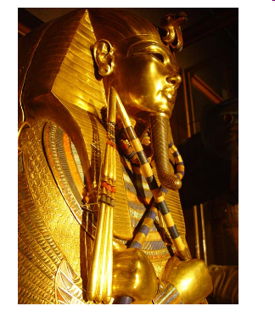
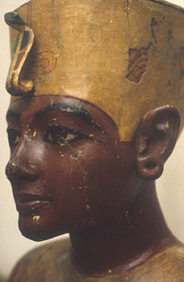
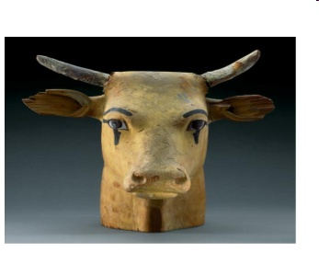
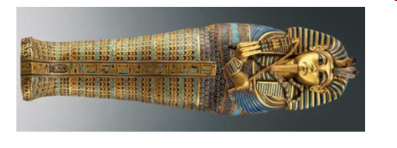
KING TUT: The child king ruled Egypt more than 3,000 years ago from the of age 8 until he was 17. There have always been questions as to whether he was truly related to the pharaohs who ruled before him.

Slide 47
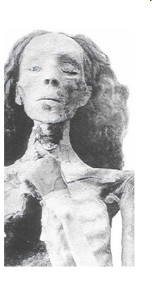
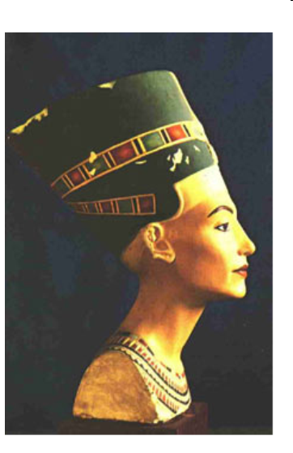
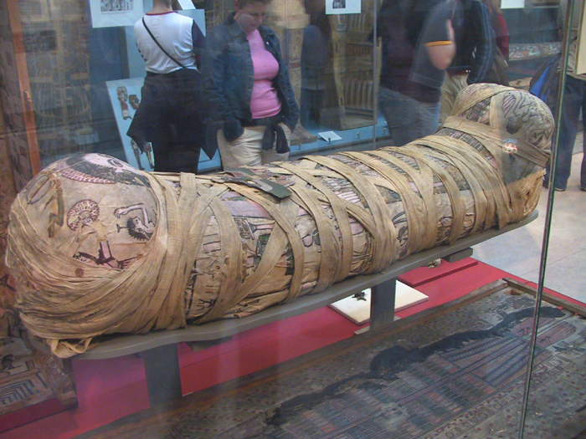
QUEEN NEFERTITI

Slide 48
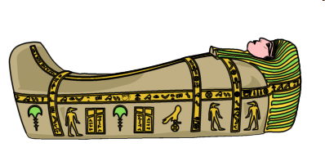
Sarcophagus
SECTION
2
Builders of the Pyramids
• Kings believed to rule even after death; have eternal life force, ka
• Build elaborate tombs, pyramids, to meet needs
after death
• Pyramids made with blocks of stone, 2-15 tons
each; 481 ft. high
• Kingdom had leadership, government;
economically strong
NEXT

Slide 49
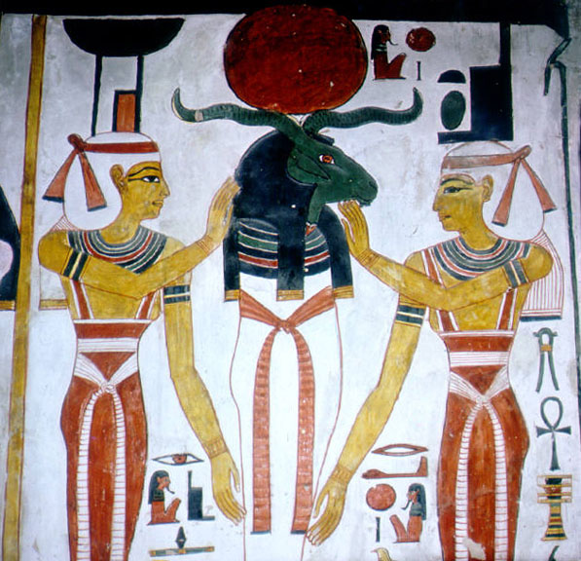
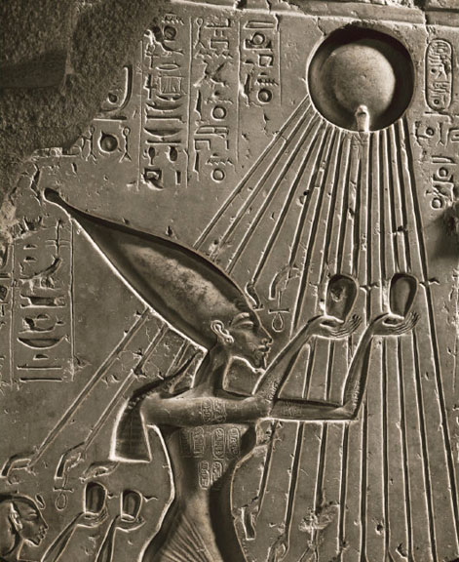
Egyptian Culture
Religion and Life
• Egyptians believe in 2,000 gods and
goddesses—polytheistic
• Re is sun god, Osiris, god of the dead; goddess
Isis is ideal woman
• Believe in life after death; person judged by
deeds at death
• Develop mummification,
process that prevents
body from decaying
• Book of the Dead contains
prayers and spells,
guides soul after death
NEXT

Slide 50
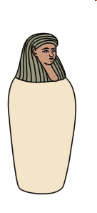
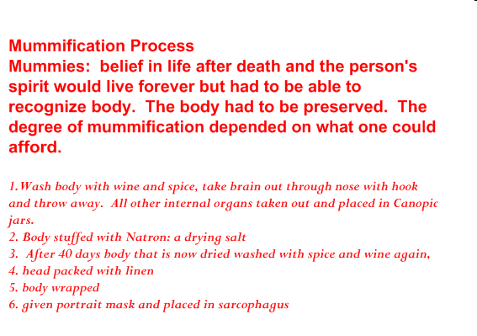
DO NOT COPY: Why do you think the heart was weighed against a feather??

Slide 51
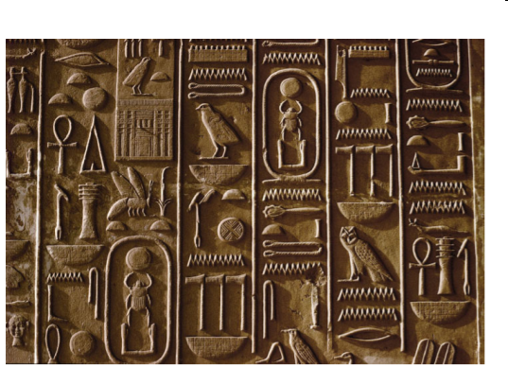
Egyptian Writing
In hieroglyphics writing system, pictures
represent ideas
Paper like sheets made from papyrus reeds used for writing
Image
NEXT

Slide 52
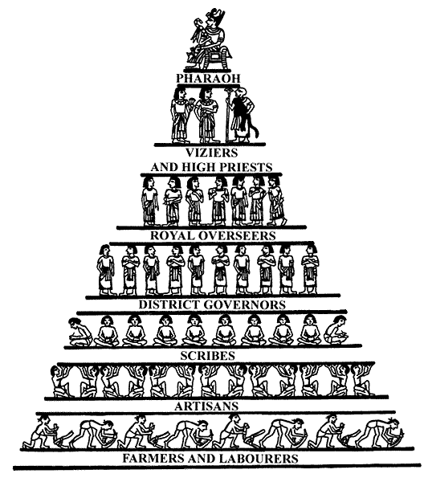
Social Classes
Society shaped like pyramid, from Pharaoh down to farmers, laborers
•Few people at top have great power; most people at bottom
•People move into higher social classes through
marriage or merit
•Women have many of the same rights as men
•

Slide 53
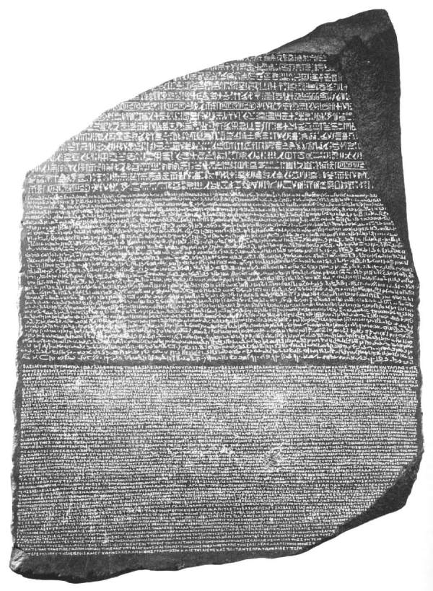
Hieroglyphics
The discovery of the Rosetta Stone was very important. It contained many languages on one stone. This discovery allowed people tp read Hieroglyphics
Rosetta Stone

Slide 54
SECTION
Egyptian Science and Technology
• Egyptians invent calendar of 365 days and 12 months
• Develop system of written numbers and a form of geometry
• Skilled engineers and architects construct palaces, pyramids
• Egyptian medicine famous in the ancient world
NEXT

Slide 55
Section 1 is completed, make sure to organize for essay question
How did geography effect the development of the Mesopotamian civilizations???

Slide 56
How did geography effect the development of early civilizations?
Location
Climate
Physical landscape
How do they irrigate crops?
What crops do they grow?
How do they trade, over land, rivers, seas?
How do they interact with the environment?
Many more questions to ask………

Slide 57
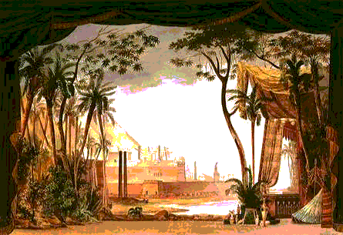

Slide 58
Planned Cities on the Indus
The first Indian civilization builds well-planned cities on the banks of the Indus River.

Slide 59
Indian Subcontinent
•Subcontinent
landmass that includes India,
Pakistan, and Bangladesh
Himalayas
World’s tallest mountain ranges separate it from rest of Asia
Continued . . .
NEXT

Slide 60
Rivers, Mountains, and Plains
• Mountains to north, desert to east, protect Indus
Valley from invasion
• Indus and Ganges rivers from flat, fertile plain—the
Indo-Gangetic
• Southern India, a dry plateau flanked by mountains
• Narrow strip of tropical land along coast

Slide 61
Monsoons
SECTION
• Seasonal winds—monsoons—dominate India’s climate
• Winter winds are dry; summer winds bring rain can cause flooding
NEXT

Slide 62
Environmental Challenges
• Floods along the Indus unpredictable; river can change course
• Rainfall unpredictable; could have droughts or floods

Slide 63
Indus Valley Civilization
• Influenced an area larger than Mesopotamia or Egypt
Earliest Arrivals
• About 7000 B.C., evidence of agriculture and domesticated animals
• By about 3200 B.C., people farming in villages along Indus River
.

Slide 64
Planned Cities
• By 2500 B.C., people build cities of brick laid out on grid system
• Engineers create plumbing and sewage systems
• Indus Valley called Harappa civilization after
Harappa, a city

Slide 65
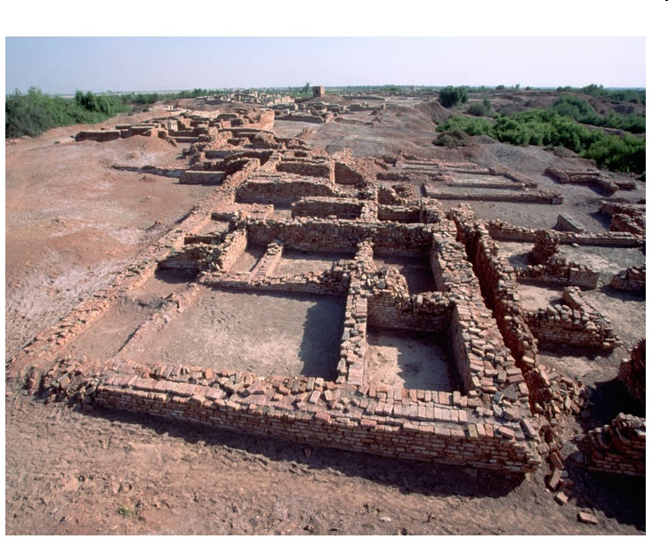
Harrapan

Slide 66
Harappan Planning
• City built on mud-brick platform to protect against flood waters
• Brick walls protect city and citadel—central buildings of the city
• Streets in grid system are 30 feet wide
• Lanes separate rows of house (which featured bathrooms)
NEXT

Slide 67
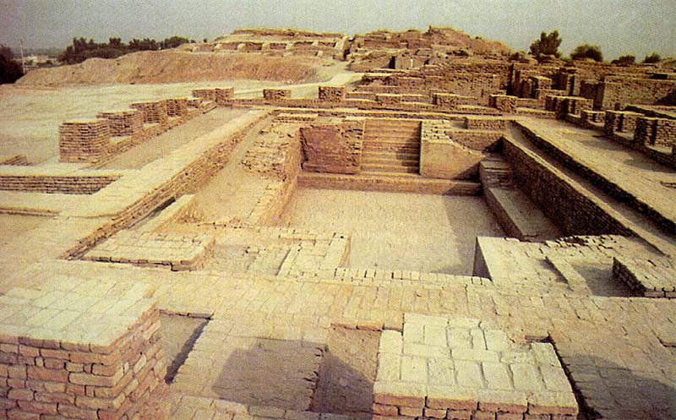
Indus Civilization

Slide 68
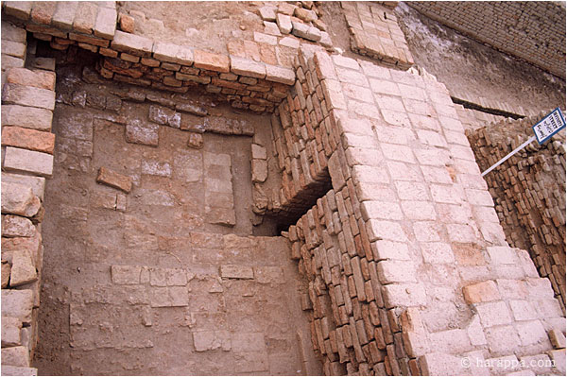
Indus Valley contd..
Contributions to the World: They had grid systems as well as plumbing
and sewage
systems.

Slide 69
Harappan Culture
SECTION
Language
• Had writing systems of 400 symbols; but scientists can’t decipher it
Culture
• Harappan cities appear uniform in culture; no great
social divisions
• Animals important to the culture; toys suggest prosperity
NEXT

Slide 70
Harappan
SECTION
Role of Religion
• Priests closely linked to rulers
• Some religious artifacts reveals links to modern Hindu culture
Trade
• Had thriving trade with other peoples, including Mesopotamia
NEXT

Slide 71
Harappan Decline
SECTION
3
• Signs of decline begin around 1750 B.C.
• Earthquakes, floods, soil depletion may have caused decline
• Around 1500 B.C., Aryans enter area and become dominant
NEXT

Slide 72
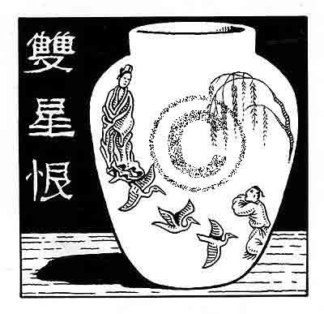
Ancient China

Slide 73
Section 4
River Dynasties in China
Early rulers introduce ideas about government and society that shape Chinese civilization.
NEXT

Slide 74
The Geography of China
SECTION
4
Barriers Isolate China
Ocean, mountains, deserts isolate China from other areas
NEXT

Slide 75
Environmental Challenges
The Geography of China
• Huang He floods can devour whole villages
• Geographic isolation means lack of trade; must be self-sufficient

Slide 76
Environmental Challenges
• Huang He floods can devour whole villages
• Geographic isolation means lack of trade; must be
self-sufficient

Slide 77
River Systems
• Huang He (“Yellow River”) in north, Yangtze in south
• Huang He leaves loess—fertile silt—when it floods

Slide 78
China’s Heartland
• North China Plain, area between two rivers, center of civilization

Slide 79
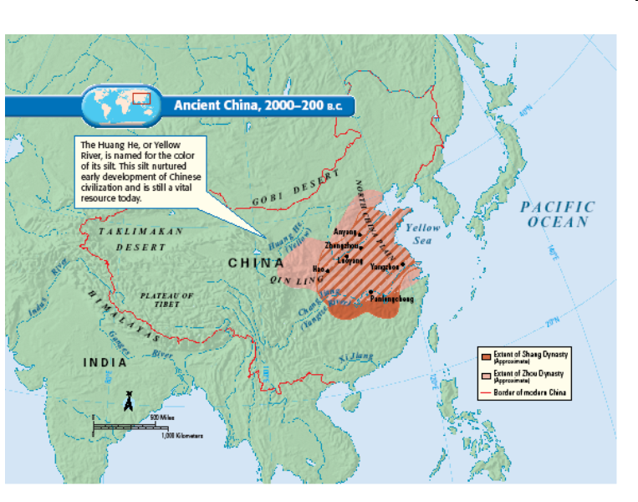
Chinese Civilization

Slide 80
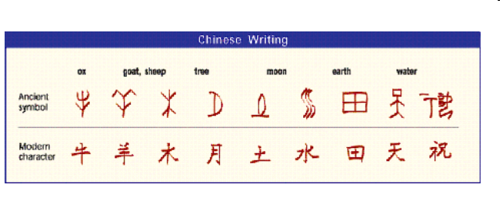
Civilization Emerges in Shang Times
SECTION
The First Dynasties
• Around 2000 B.C. cities arise; Yu, first ruler of Xia Dynasty
• Yu’s flood control systems tames Huang He
• Shang Dynasty, 1700 to 1027 B.C., first to leave written records
NEXT

Slide 81
Zhou and the Dynastic Cycle
The Zhou Take Control
In 1027 B.C., Zhou Dynasty takes control of China
Mandate of Heaven
Mandate of Heaven—the belief that a just ruler had divine approval
Developed as justification for change in power to Zhou
Continued . . .
NEXT

Slide 82
Control Through Feudalism
• Feudalism—system where kings give land to nobles in exchange for services

Slide 83
Religious Beliefs
• Spirits of dead ancestors can affect family fortunes
• Priests scratch questions on animal bones and tortoise shells
• Oracle bones used to consult gods; supreme god, Shang Di

Slide 84
Development of Writing
• Writing system uses symbols to represent syllables; not ideas
• People of different languages can use same system
• Huge number of characters make system difficult to learn

Slide 85
Chinese Civilization
• Sees China as center of world; views others as uncivilized
• The group is more important than the individual

Slide 86
Family
• Family is central social institution; respect for parents a virtue
• Elder males control family property
• Women expected to obey all men, even sons

Slide 87
Social Classes
• King and warrior-nobles lead society and own the land

Slide 88
Improvements in Technology and Trade
• Zhou Dynasty builds roads, canals to improve transportation
• Uses coins to make trade easier
• Produces cast iron tools and weapons
food production increases

Slide 89
What to do: Plan and Organize
Begin to gather your facts: You will take notes on civilizations in each of the 4 river valleys
As you copy notes underline anything that you see that has to do with geography
Begin to organize these facts into categories
Try to find several common themes that all the areas share
You will be allowed to bring in your organized notes to compose this essay
You will have 1 class period to compose your response to this question. You must complete this essay in class.

Slide 90
Essay Question
At the end of this unit part of your test will be to answer the following essay question
How did geography effect the development of early civilizations?

Slide 91
How did geography effect the development of early civilizations?
Location
Climate
Physical landscape
How do they irrigate crops?
What crops do they grow?
How do they trade, over land, rivers, seas?
How do they interact with the environment?
Many more questions to ask………

Slide 92
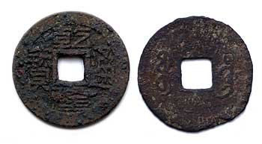
Innovations
Roads and canals were built to stimulate trade and agriculture.
Coined money was introduced, which further improved trade.
Blast furnaces that produced cast iron.
Old Chinese Money

Slide 93
What to do: Plan and Organize
Begin to gather your facts: You will take notes on civilizations in each of the 4 river valleys
As you copy notes underline anything that you see that has to do with geography
Begin to organize these facts into categories
Try to find several common themes that all the areas share
You will be allowed to bring in your organized notes to compose this essay
You will have 1 class period to compose your response to this question. You must complete this essay in class.

Slide 94
Essay Question
At the end of this unit part of your test will be to answer the following essay question
How did geography effect the development of early civilizations?

Slide 95
How did geography effect the development of early civilizations?
Location
Climate
Physical landscape
How do they irrigate crops?
What crops do they grow?
How do they trade, over land, rivers, seas?
How do they interact with the environment?
Many more questions to ask………

